Slide 1
vTools Training | Regions 4/5/6 Meeting
January 30, 2016

Slide 2
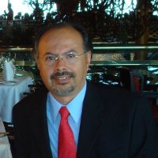
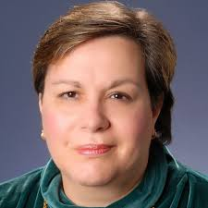
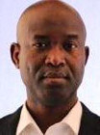
Welcome
Francisco Martinez
Chair, ITCO
Vice-Chair, MGA IM
Vera Sharoff
Director, MGA IM
Wole Akpose
Chair, vTools

Slide 3
Presenter
Wole Akpose
IEEE vTools, Chair.
wole@ieee.org

Slide 4
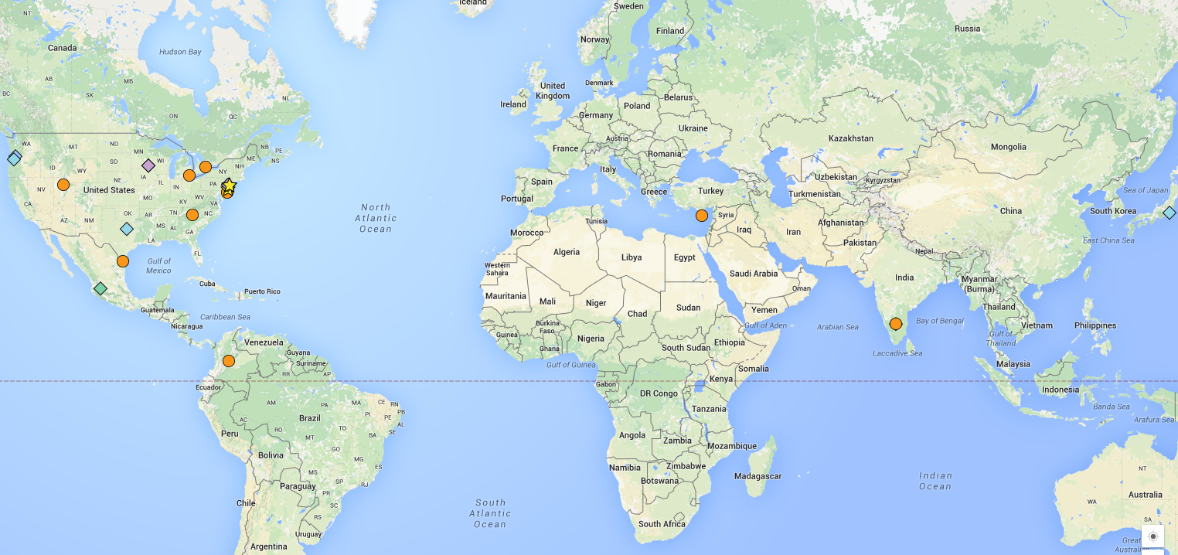
2015 vTools Committee

Slide 5
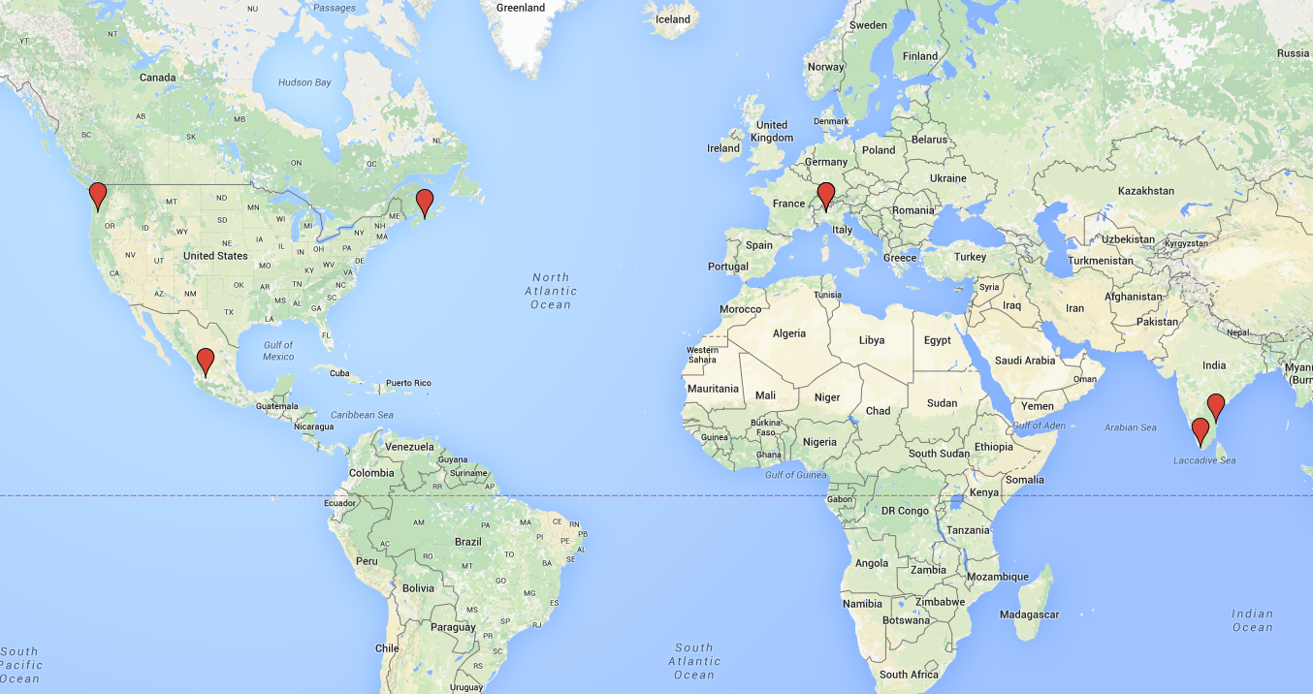
2015 ITCO

Slide 6
Micro Volunteering
What is it:
Pick a task you are interested in
work alone or with a team to create a solution
No long term commitment
Requirements:
Passion
Subject matter expertise.
Contact : wole@ieee.org

Slide 7
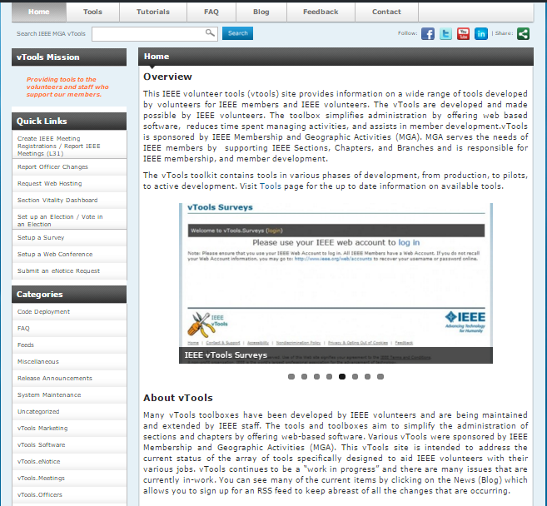
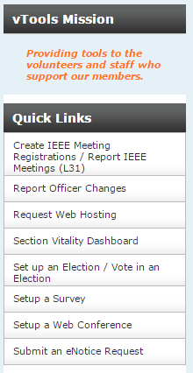
vTools Portal

Slide 8
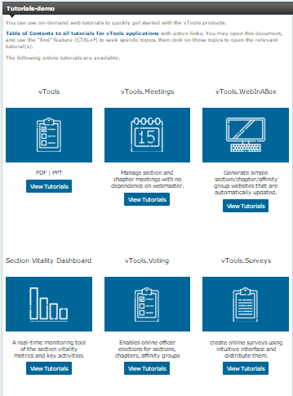
vTools Portal

Slide 9
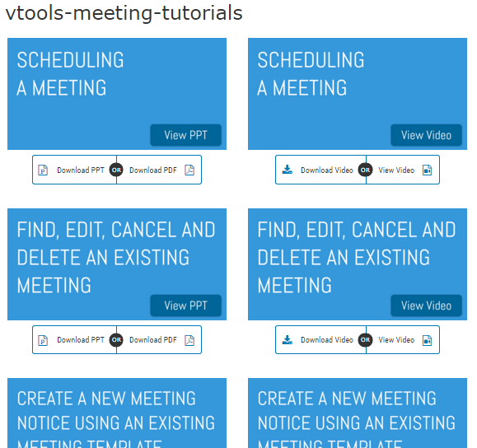
vTools Portal

Slide 10
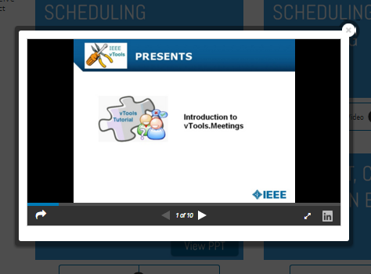
vTools Portal

Slide 11
IEEE Google / Google 4 OU (G4OU)
Accessing IEEE Google
Google Drive
Google for OU
  Email Groups (Google Group for Business)
  Shared Drive
  Listserv
  Shared Calendar

Slide 12
Google Hangout
Google +
Google + Community
Google+ Page
Google Hangout
Hangout on Air

Slide 13
Google Hangout on Air
When to use Hangout on Air
Planning → see Hangout
Hosting Hangout on Air (steps)
Recording Hangout on Air
Sharing Hangout on Air (Broadcast via Youtube)

Slide 14


Slide 15
Closing Remarks

