Slide 1
Vision to Action:
Transforming Educational Activities
S. K. Ramesh,
2016 VP IEEE-EAB
s.ramesh@ieee.org

Slide 2
Educational Activities – Who do we serve?
Educational Activities
Students & Educators
Practitioners
Public
Be the recognized and respected portal for educational resources, global in reach but local in relevance, supporting life-long learning and catalyzing change through education.

Slide 3
Educational Activities Board Mission
The EAB shall recommend to the Board of Directors policies on educational matters and implement programs specifically intended to serve and benefit IEEE members in educational pursuits, the engineering and scientific community, and the general public.
These programs shall include:
Mission 1
Mission 2
Mission 3
The broad planning of educational activities of the IEEE
The development and delivery of continuing education products and activities.
Mission 4
Mission 5
The development of guidelines for the IEEE representatives to accreditation bodies
The monitoring of accreditation activities
Mission 6
The coordination of pre-university programs
The representation of the IEEE in matters regarding engineering education
And, the EAB shall be the IEEE interface in education-related matters with external bodies. EAB shall be responsible for administration of the annual assessment paid to ABET (formerly the Accreditation Board for Engineering and Technology, Inc.)

Slide 4
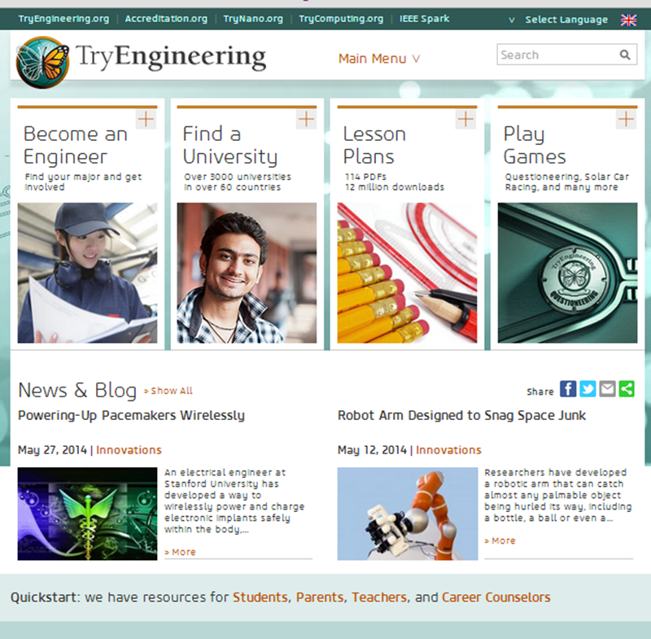
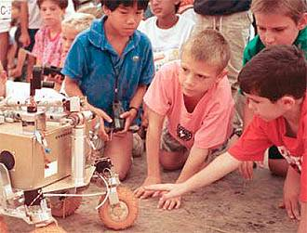


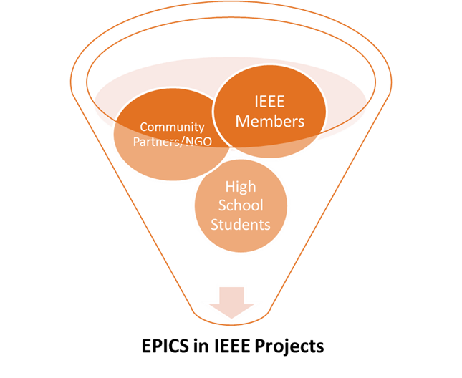

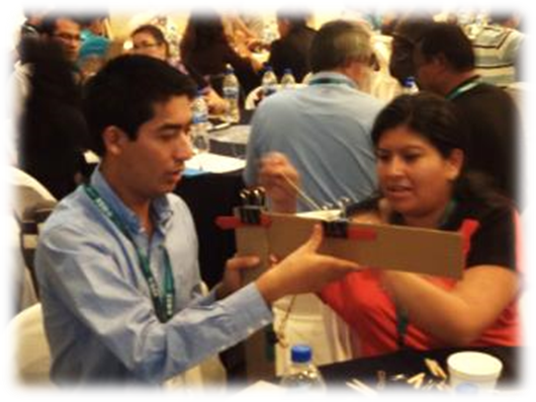


Pre-University Education – Online Portals and Signature Programs
TISP

Slide 5
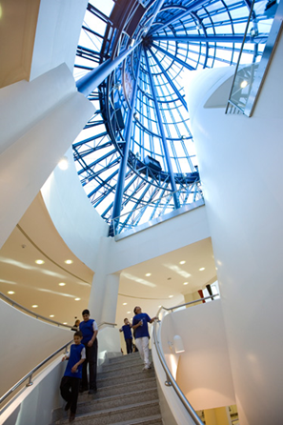



University Education
Resources for Students
Early Career Faculty Development
ABET Accreditation
Global Accreditation

Slide 6

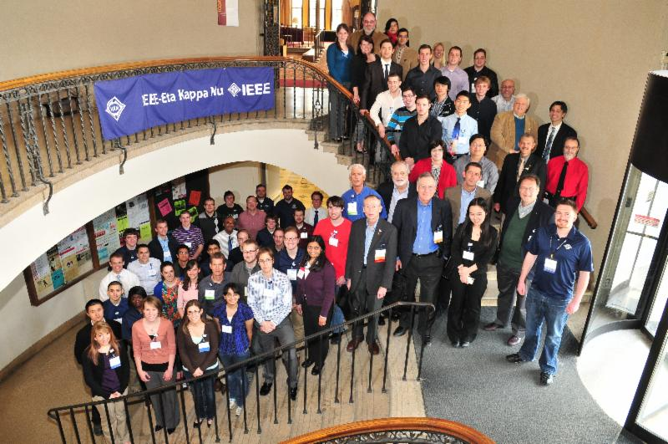
IEEE-Eta Kappa Nu (IEEE-HKN)
Honor Society of IEEE
Dedicated to encouraging and recognizing individual excellence in:
Education and meritorious work
Professional practice, and
Any of the areas within the IEEE-designated fields of interest

Slide 7
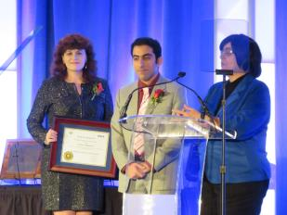
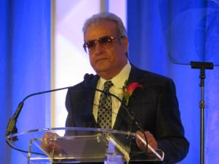
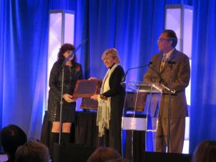
IEEE EAB Awards
Recognize excellence and outstanding educational contributions
of individuals and organizations through awards that are
aligned with EAB’s educational vision and mission.
10 Awards and 2 Scholarship Awards

Slide 8
Snapshot of EA’s budget

Slide 9
Cost Centers Outside EA

Slide 10




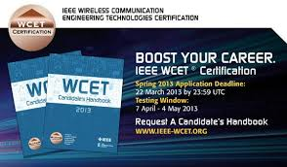
IEEE Continuing Education - 2016
Customized Education Solutions

Slide 11




Challenges

Slide 12





How do we expand our Programs?

Slide 13
Can we do it?
You bet! And we’ll do it the IEEE way
Inquire, Engage, Excite, Energize
Questions?

