Slide 1


IEEE Conference on Technologies for Sustainability
2016 IEEE Regions 4, 5, and 6 Joint Meeting and IEEE-USA Awards Banquet, Las Vegas
January 29, 2016
Gopi Krishnan
Chair - Organizing Committee, 2016 Sustech

Slide 2



Environmental Sustainability
Environmental sustainability is a recognized issue of global proportions*

Slide 3
IEEE Sustech Conferences
The IEEE Conference on Technologies for Sustainability (Sustech) is an annual conference that aims to address & explore the development and application of science, engineering and technology to promote sustainability.
The conference in its 4th year is uniquely positioned to address a span of sustainability topics and technical content.
Broad Sustainability Topics
Technical Content

Slide 4
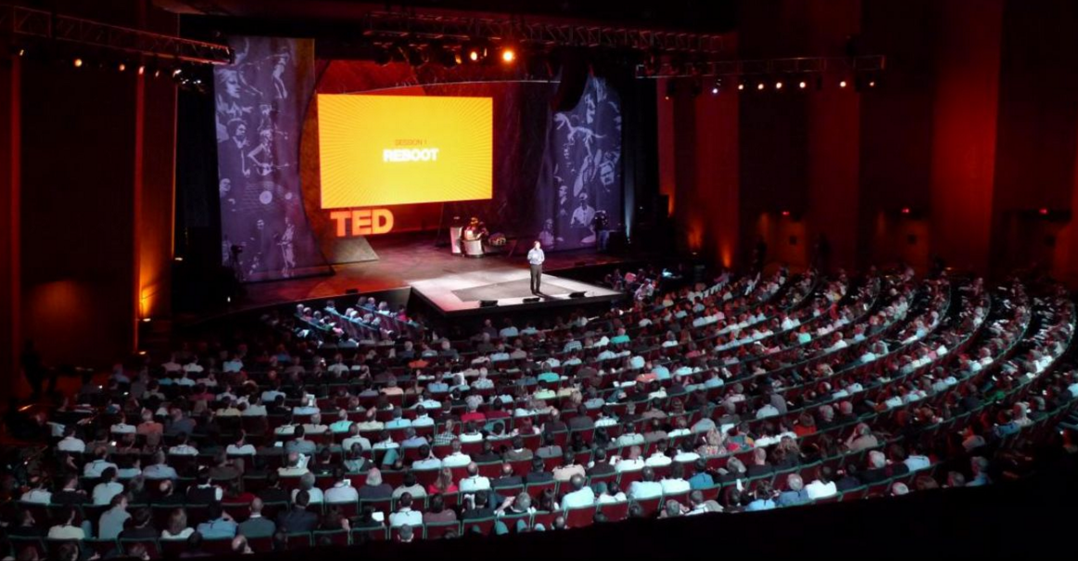
Goals for Sustech
Make Sustech a go-to conference on the IEEE and green circuit !

Slide 5

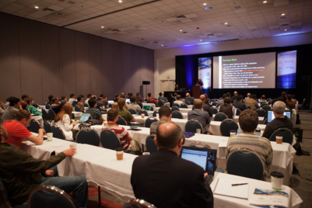
The 2016 Conference Overview
The 2016 conference will be held Phoenix, AZ b/w Oct 9th and Oct 11th, 2016
The plan for the three day conference includes technical presentations, keynote speakers, panel discussions, vendor expo, professional development courses (e.g. Makers and Sustainability, Entrepreneurship in Cleantech, Power & Energy, Strategies to reduce personal footprint)
Topics will include Internet of Things, Energy, Smart Cities, Manufacturing, People and Policy.

Slide 6
Call to Action
We have 8 months to the conference !
Need passionate volunteers interested in taking a leadership role particularly Program, Track, Publicity, Sponsorship chairs
Call to action: As a section/activity chair/leader if you think there will be interest in your community in leading, organizing, participating, or learning more, please contact me. If not, I will contact you ☺
Gopi Krishnan
Chair, 2016 Sustech
gopi.krishnan@intel.com

Slide 7
“Humankind has not woven the web of life. We are but one thread within it. Whatever we do to the web, we do to ourselves. All things are bound together … all things connect.”
—Chief Seattle

