Slide 1
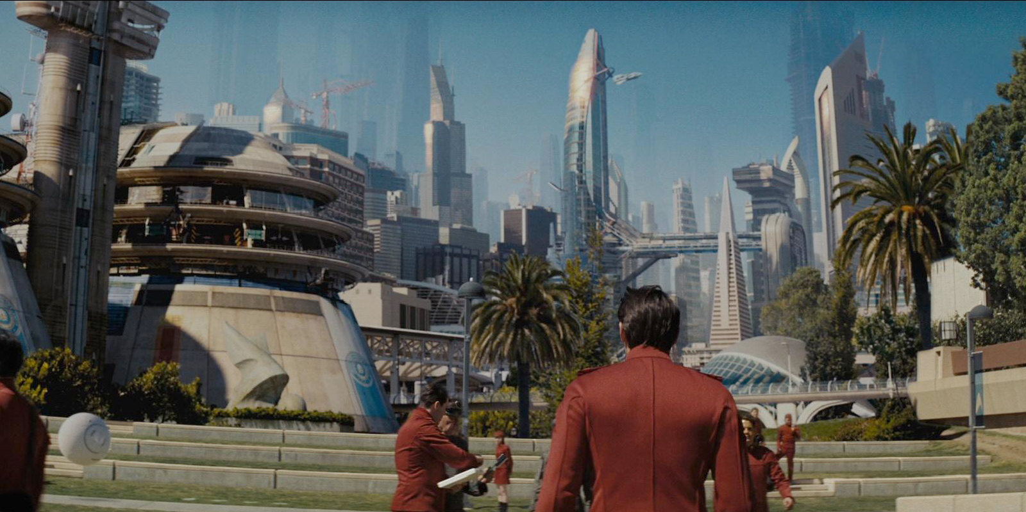

IEEE Region 6
No Limits
Tom Coughlin
Region 6 Director
January 29, 2016

Slide 2
Outline
No Limits!!!
2016 Region 6 Prime Imperative
2016 Region 6 Plans to Accomplish this Imperative
Other Region 6 stuff

Slide 3
What are our limits?
There are limits to resources
There are limits to time, space and energy
But to the prepared mind, there are no limits to knowledge
And that makes all the difference

Slide 4
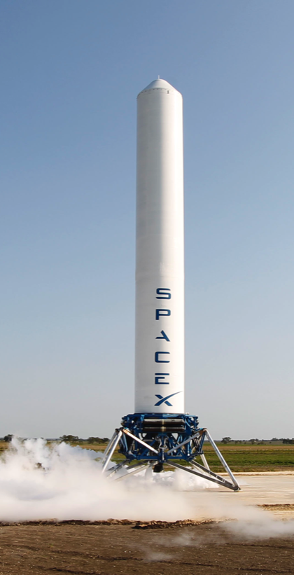
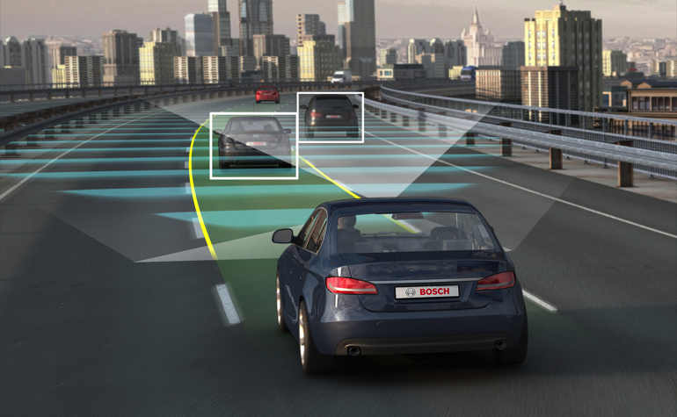
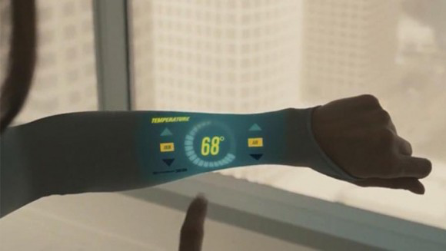

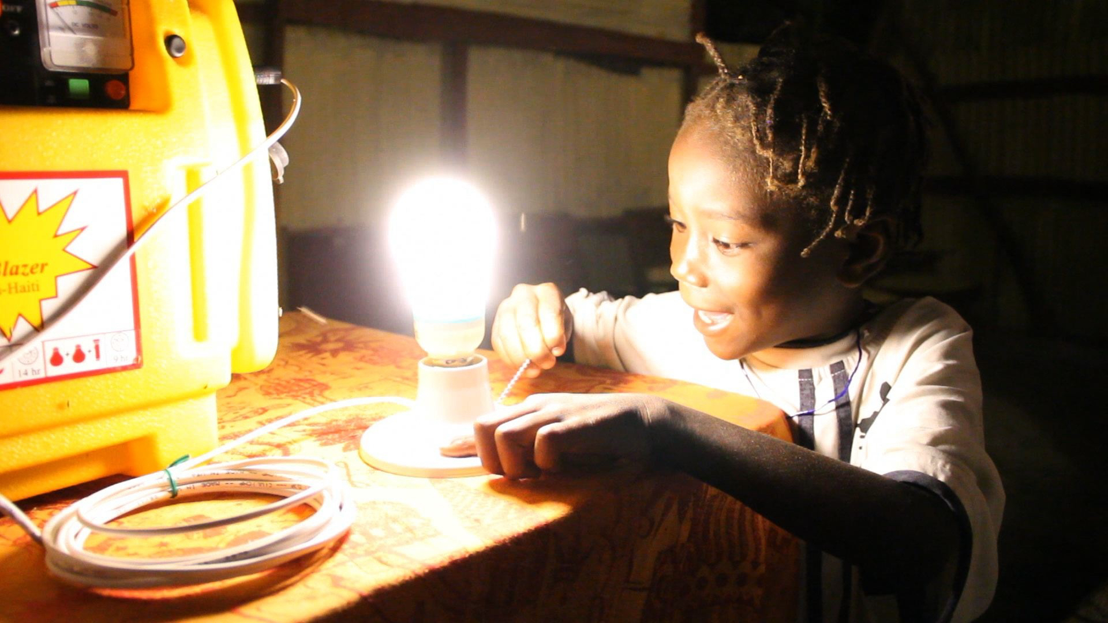
The Engineer
We can accomplish amazing things with a reasoned optimistic attitude
There is more to learn than has ever been learned
There is more to do than has ever been done, and
There is a greater need than ever for those who know how to do things—the engineers

Slide 5
Vol-un-teer
My definition: A really generous person who contributes their time, passion and vision to help get things done and change the world
Dictionary: A person who freely offers to take part in an enterprise or undertake a task
Thanks for being a volunteer!

Slide 6
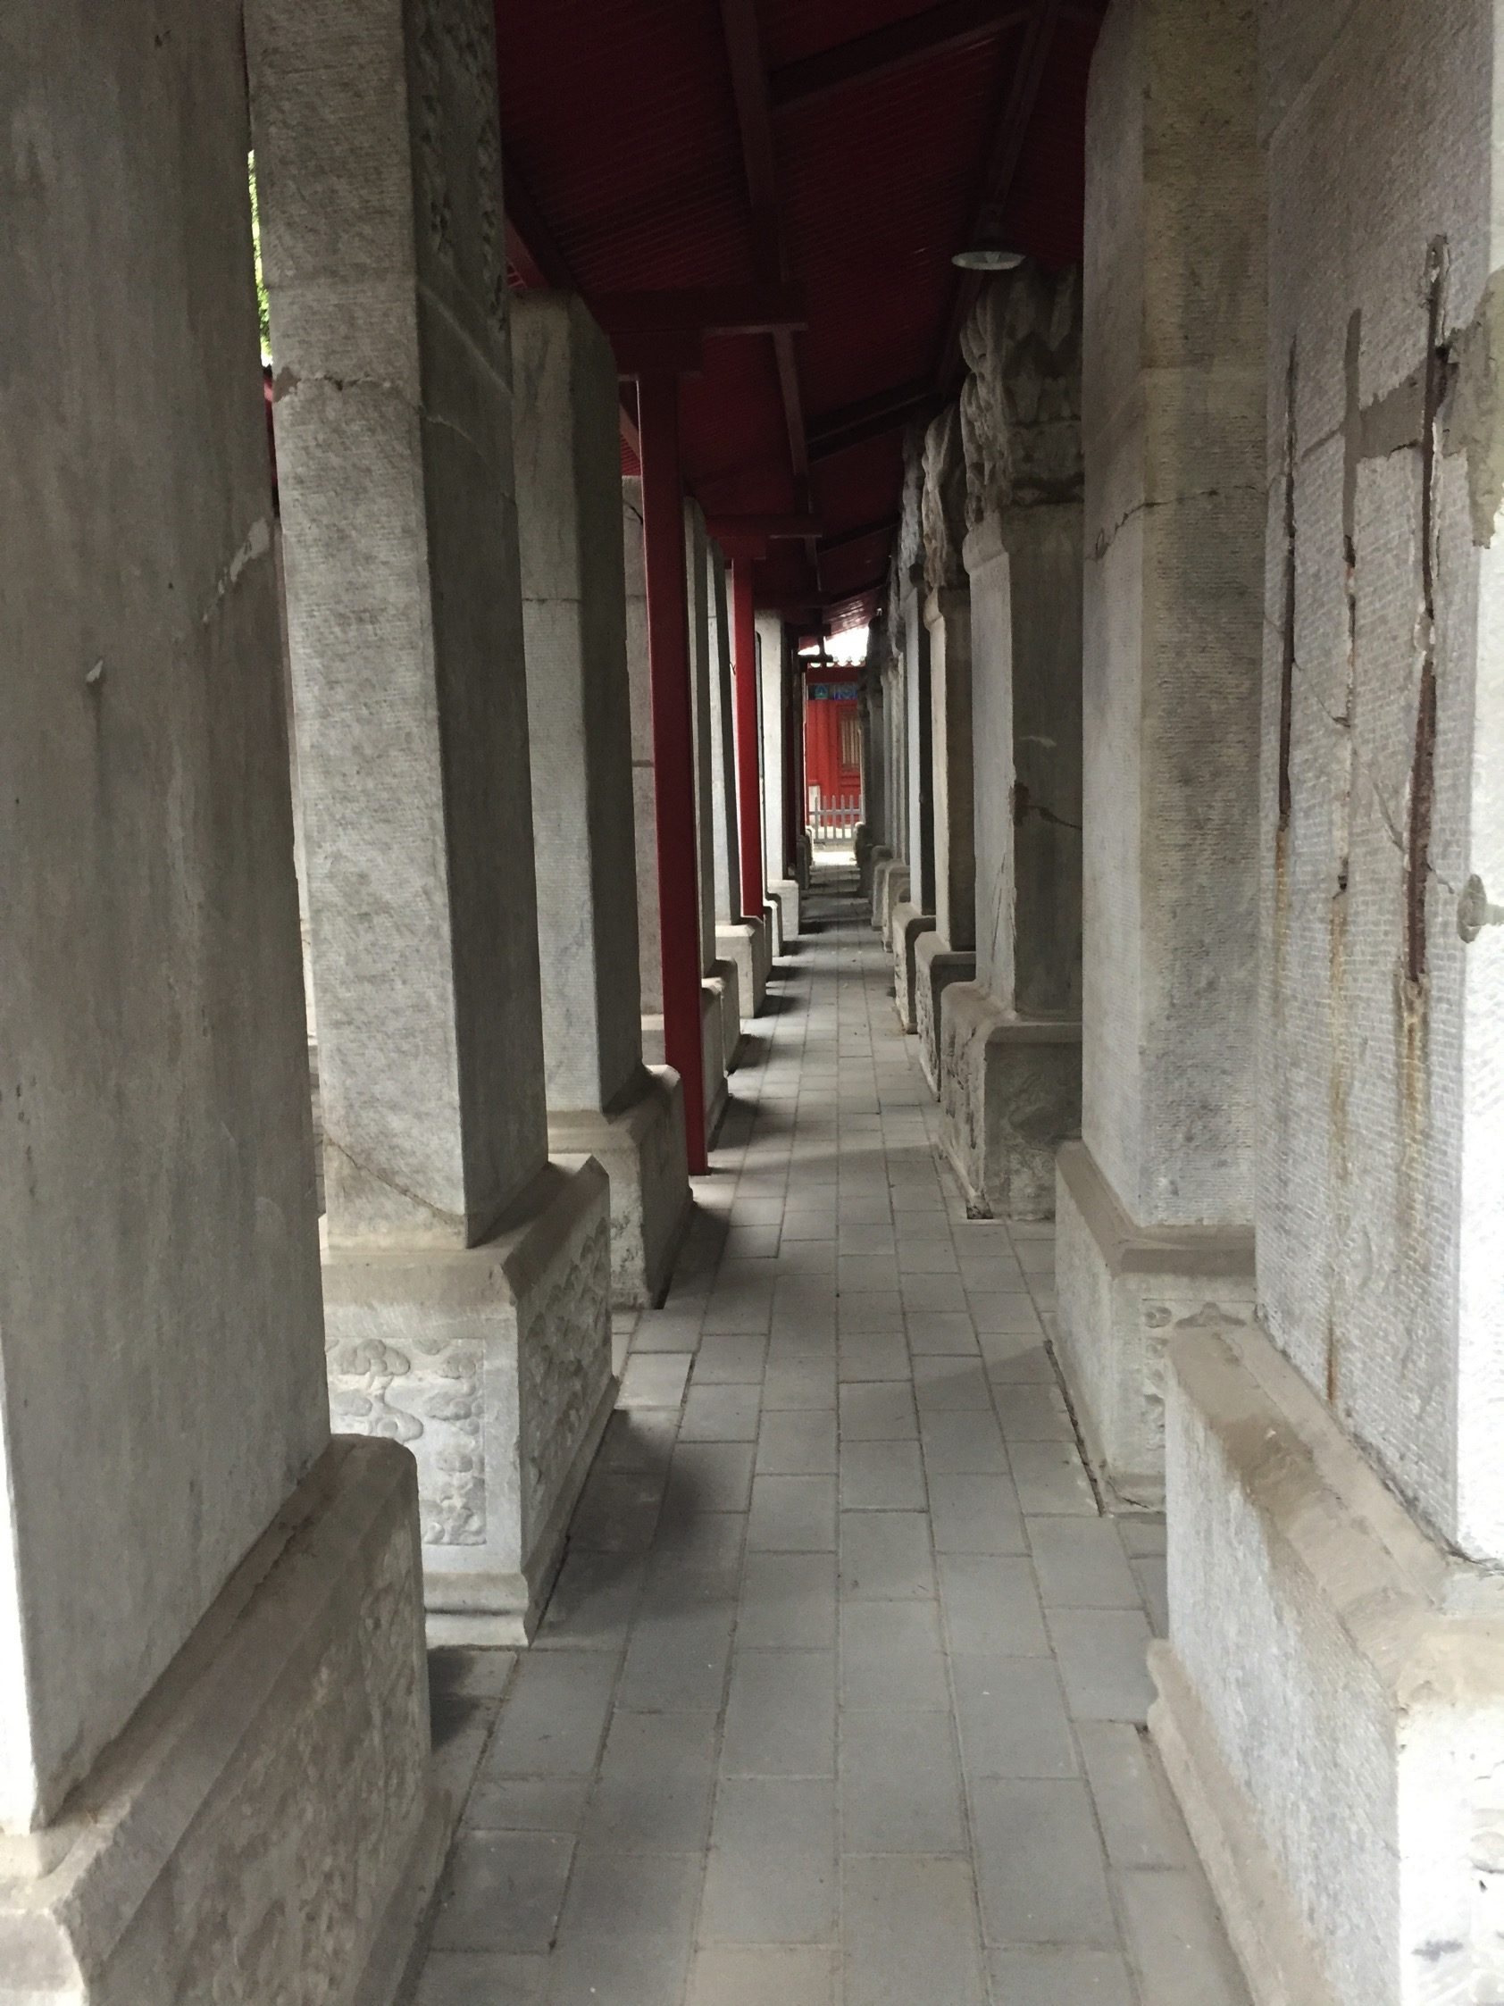
The
PRIME IMPERATIVE

Slide 7
Region 6 Prime Imperative for 2016
Increase overall IEEE membership by 1.0% in 2016 from 2015

Slide 8
Region 6 - High Grade Members 2000-2014

Slide 9
Increasing IEEE Membership
Everything we do in Region 6 in 2016 must focus on enhancing the value of IEEE membership
  Getting to word out about what we have to offer
  Getting volunteers engaged to recover non-renewing members,
  Creating mentorships between students and full members and tighter connections between sections and student branches
  Increasing our presence in STEM and humanitarian activities
  Create PACE events that enhance membership value
  Expand our chapter recording initiative to enhance the value of IEEE membership
  Help our members find jobs and with career training
  Create stronger ties with Region 6 industry
  Increasing our senior membership beyond current goals
  Making IEEE cool—we have the shirts!

Slide 10
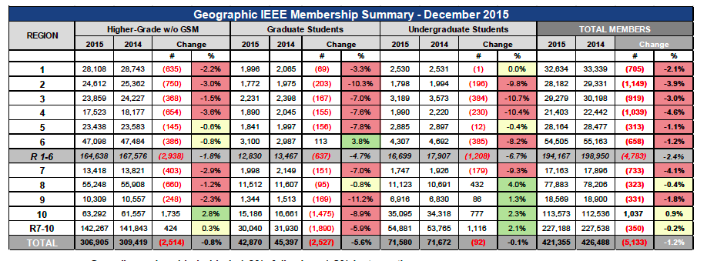
2015 Membership Results
(Dec 2015)
We want to go from a 1.2% membership loss in 2015 to a 1% membership gain in 2016—about a 545 net member gain

Slide 11
Membership Initiative –
Member to Member Renewal
Towards the end of February 2015 IEEE terminated membership for folks that didn’t renew their membership
From March 2015 to the end of May 2015 Region 6 began a pilot micro-volunteer program, with IEEE Membership Recruitment, to get IEEE volunteers to sign up to make calls to a list of 10 people in their section
We created an incentive program for callers who are able to get terminated members to renew
We had over 60 people who signed up to do these calls
Based upon the results of these calls we intend to repeat this activity next year

Slide 12
Member to Member Renewal Results
Region 6 volunteers reached out to 285 non-renewing members. Of the calls made 31.6% connected and 42.5% had a message that was left via voicemail or followed up with an email.
The effort paid off in that 19% of these contacts ultimately ended up renewing. The team was also able to gleen some valuable insights into why members did not renew.
Partially due to this effort our membership renewal numbers were much higher than in past year (up by almost 10%).
We want to start this process earlier in 2016-starting in February.

Slide 13
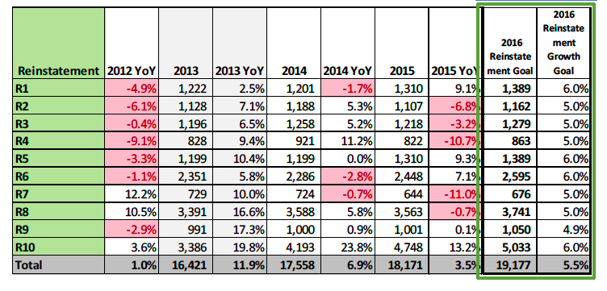
2015 Reinstatements Up in Region 6
September 2015 MD Report

Slide 14
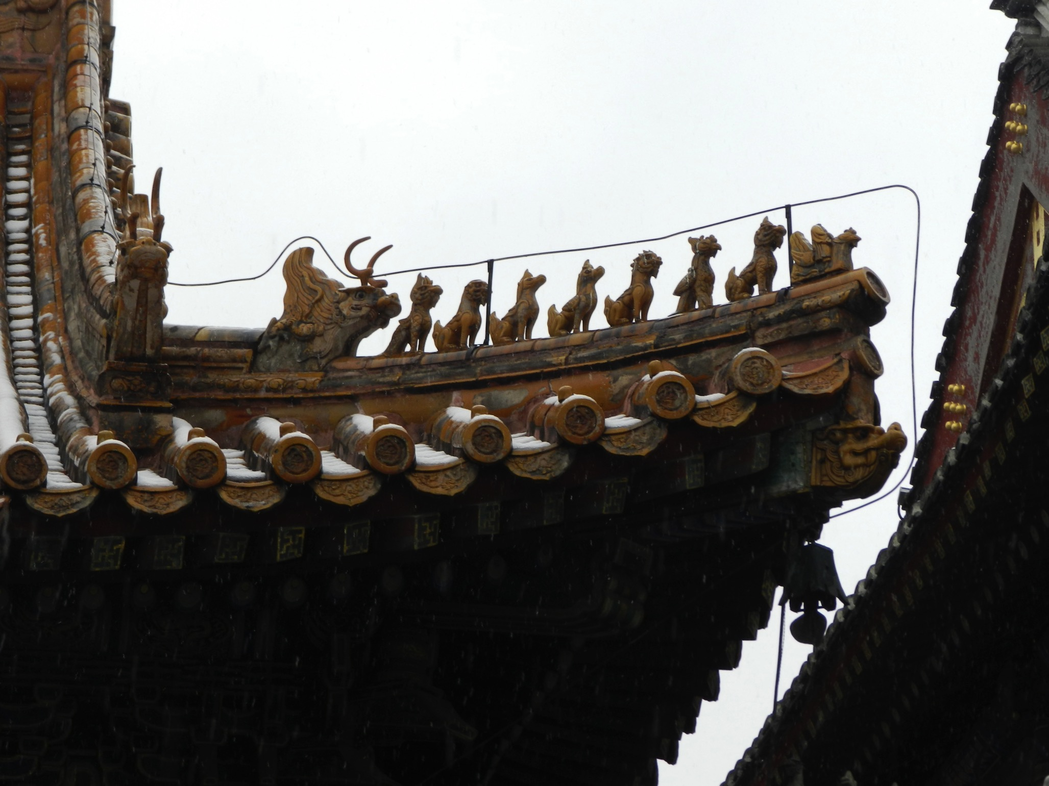
The Next Generation

Slide 15
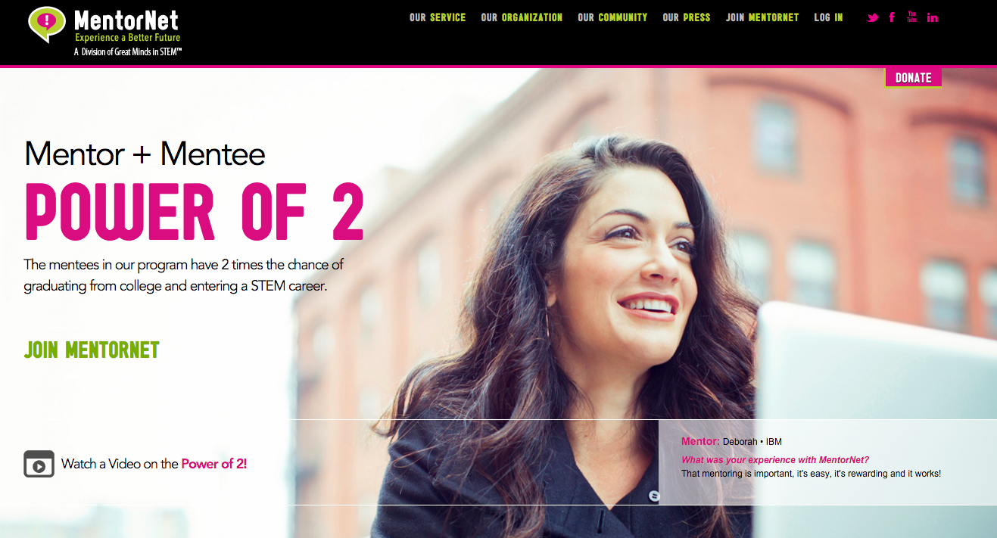
MentorNet

Slide 16
MentorNet (2)
MentorNet is a social network for mentoring open to any STEM student in the US. STEM students are mentored by professionals working in the STEM fields.
IEEE Region 6 has licensed MentorNet for a year to help us connect IEEE students with IEEE professionals as part of our membership growth plan--encouraging students to full IEEE membership
We are creating a sign up form on the Region 6 web site where people can sign up to volunteer for activities such as being a mentor (http://ieee-region6.org/volunteer/)
More information on joining MentorNet and finding somone to mentor in the next few weeks

Slide 17
Region 6 Student-Targeted Efforts
Improve student branches by improving section relations with their student branches.
  Communication and supporting involvement in wider IEEE activities.
Improve effectiveness of area meetings for student members
  Revising Student Leadership Training.
  Making student competitions more relevant and appealing.

Slide 18
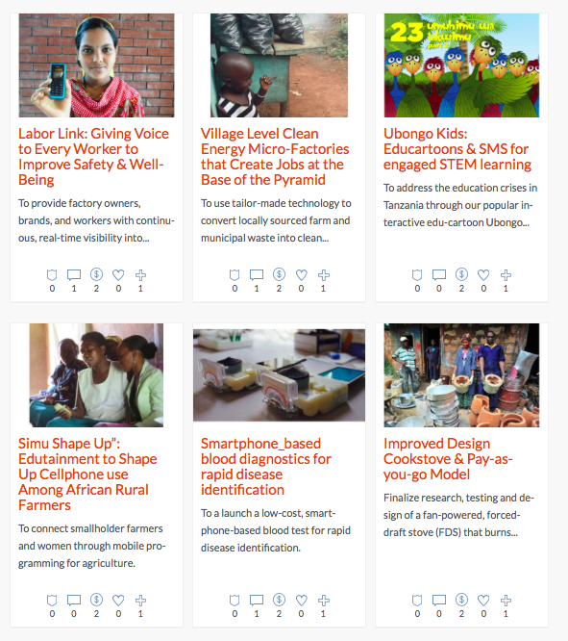
Region 6 Partnership with Global Innovation Exchange
Create a coordinated R6 SIGHT committee and incorporate humanitarian projects in our new student training initiatives

Slide 19
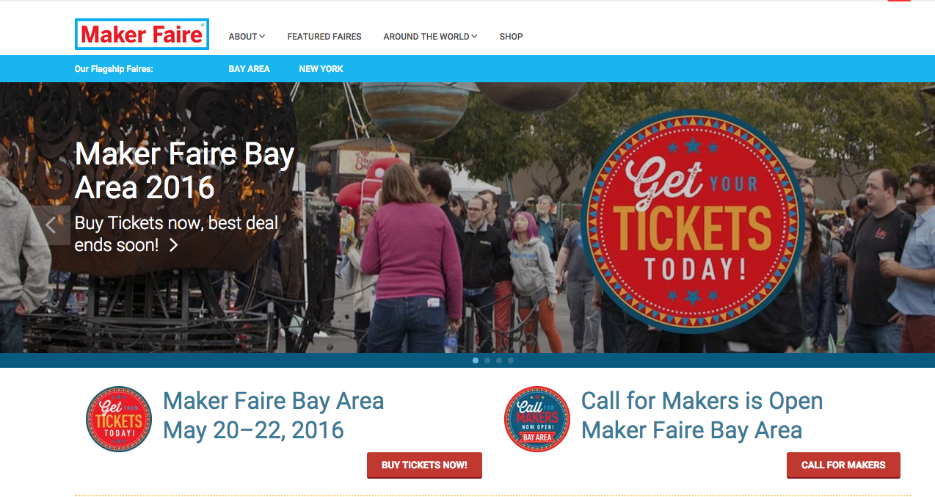
Maker Faires

Slide 20
Maker Faires and other STEM Activities
IEEE Region 6, in combination with the SF Bay Area sections and possibly IEEE will have a major presence at the May Maker Faire in San Mateo
The Region will invest some money to raise our presence there
We want to have additional presence in Maker Faires throughout Region 6 and partner with Make Media to create new MK’s
We also want to have an increased and visible presence at FIRST Robotics, Future Cities and other STEM competitions and activities

Slide 21
Region 6 is committed to STEM outreach
Funding for STEM outreach
  It’s our future
  It can be 3% or 33%...but not 0!
  Even if it’s not YOUR cup of tea--Delegate! Frequently but not exclusively, a PACE function
Sections provide and communicate options to members, encourage involvement, publicize successes
  Appoint a Pre-college Outreach Chair
  Hold at least ONE precollege STEM event in 2016
  Tell your Region about it!
See our website: http://ieee-region6.org/k-12-programs/

Slide 22
Region 6 PACE in 2016
We spent all our budgeted 2015 PACE money by June—first time ever! Great job to all the sections and branches that planned activities
In 2016 we want to spend even more on PACE that enhances IEEE membership
We want all sections to do at least one PACE funded activity in 2016
We received extra money from IEEE USA for PACE in 2015 and plan to ask again in 2016.
PACE is an important tool in showing the value of IEEE membership

Slide 23
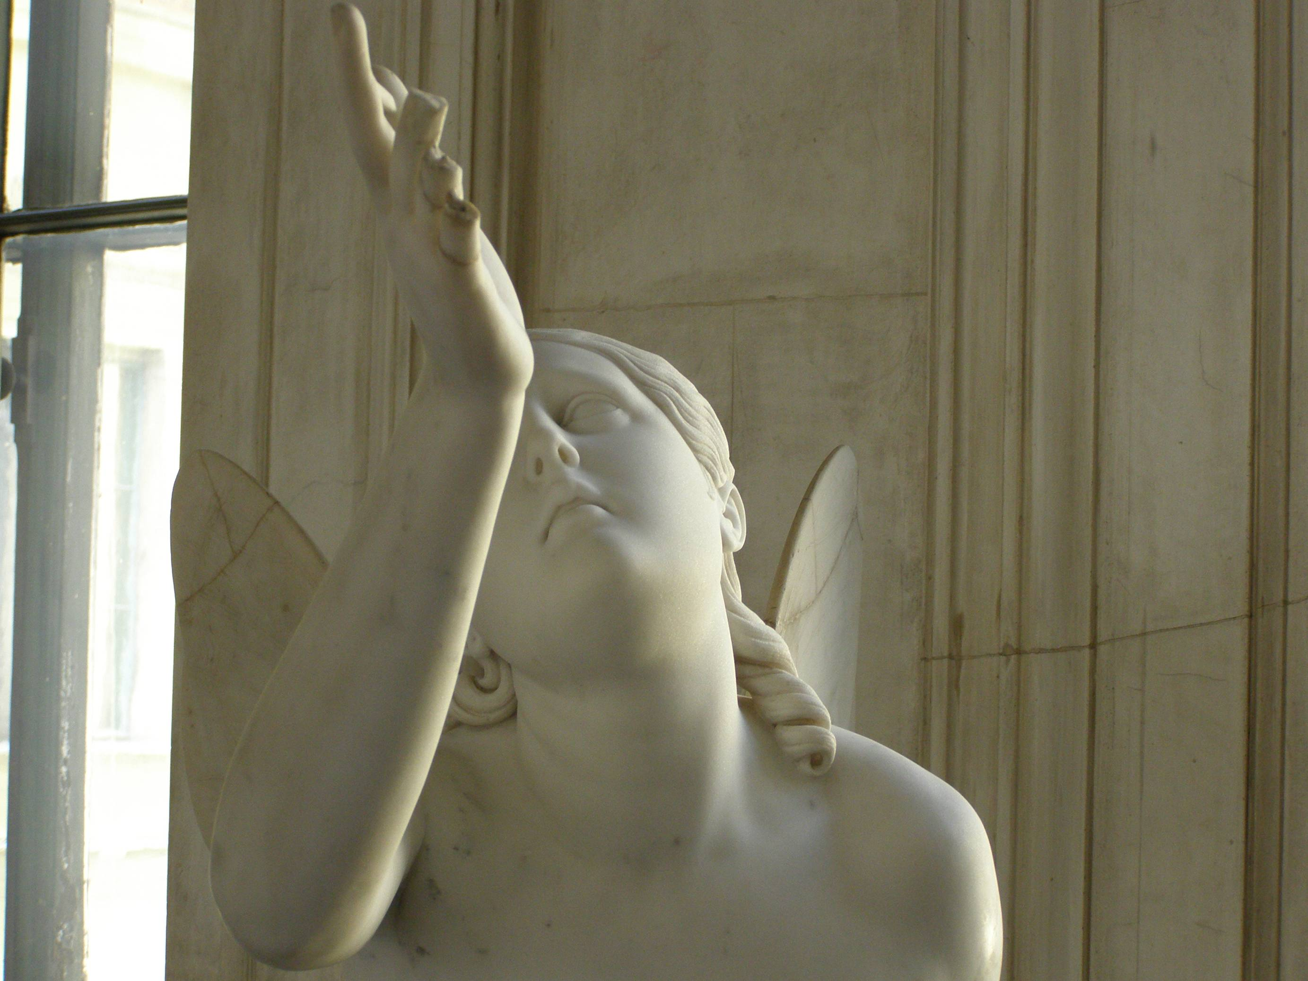
Creating More Value

Slide 24
Create an On-Line Collection of Technical Chapter Meeting Recordings
IEEE New Initiatives Comm. (NIC) funding of a pilot program in Region 4 and Region 6 in 2015 and again in 2016
We are hosting these recordings—they are available for free to all IEEE members on our beta site, www.nuxlabs.org
We intend to sell access to these recordings to non-members--enhance IEEE membership
We could have 100’s of these in a year’s time, 1000’s in 5 year’s time—this is cutting edge material
We are offering discounts for microphone packages and offering Camtasia licenses. We are doing training to section and chapter leaders—Contact Scott Tamashiro if you are interested in these packages (Scott Tamashiro (tamashiro@ieee.org) .

Slide 25
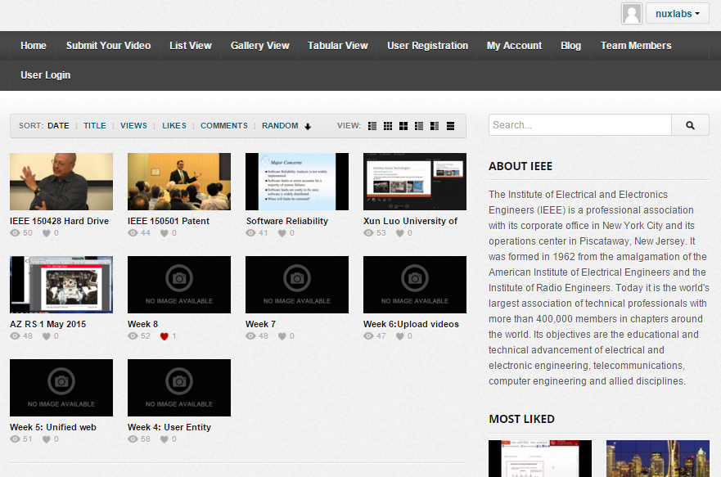
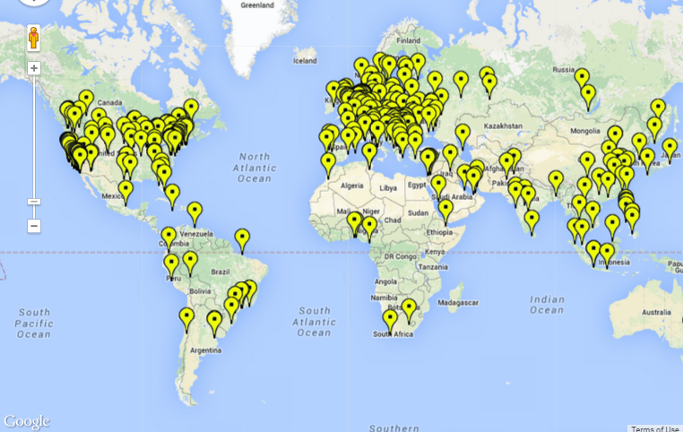
Recorded Meetings Initiative
Recording OU (Section/Chapter Meetings using Camtasia software and microphone sets
Videos are archived and can be easily searched with filter criteria
Phase I attracted 82 recorded meetings and 5902 total views
SSO and IEEE Cart Integration in progress for membership benefit differentiation and potential revenue generation

Slide 26
January 2016 Career Expo (http://sites.ieee.org/r6careerexpo/)
20 company booths, 13 society and resource booths
4 live webinars (over 4 hours)
429 registrants with only 7 no-shows. 227 were IEEE members and 202 were guests
250 people attended the live event
Partial breakdown of participants:26 from R1, 2 from R2, 11 from R3, 4 from R4, 16 from R5, 112 from R6, 2 from R7, 6 from R8 and 13 from R10
We plan to add 21 companies to the April event which will feature a special invite and free passes to US veterans in technology

Slide 27
Membership Initiative –
Elevations
Associate to Member elevation information (this Is a very simple process): http://www.ieee.org/membership_services/membership/grade_elevation.html
Senior membership elevations
  Let’s organize local activities to get eligible members elevated
  This recognizes our members for their experience and may help with retention
  We want to exceed the official goal for senior member elevation in 2016

Slide 28
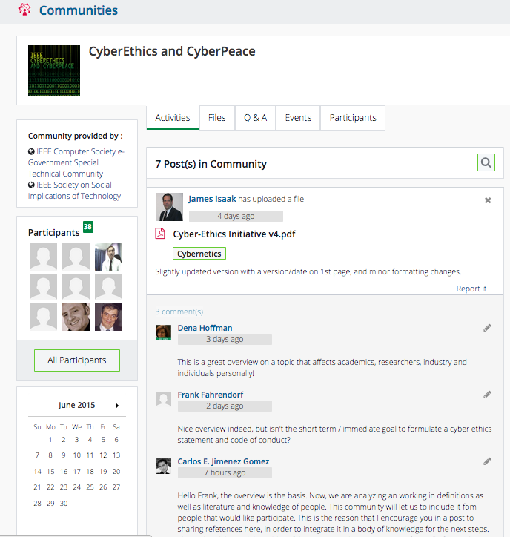
Communities provide technology professionals collaborative opportunities
Community of participants sharing similar fields of interests from around the world may:
Share, view, and download files to garner opinions on the latest technology or research
Comment on files to trigger discussions and share opinions
View events related to technical or geo interests
Notes:
Sandeep Sharma
Program Director, IEEE Collabratec | Member and Geographic Activities
Office: +1-732-562-5440 | Mobile: +1-732-910-6908 | Email: sharma.sandeep@ieee.org

Slide 29



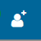
Next Steps: What should YOU do?
Sign-in to ieeecollabratec.org
Set-up your profile, add interests, build your network
Join communities and make a post or ask a question
Promote to IEEE authors and your colleagues and send invitations to join

Slide 30
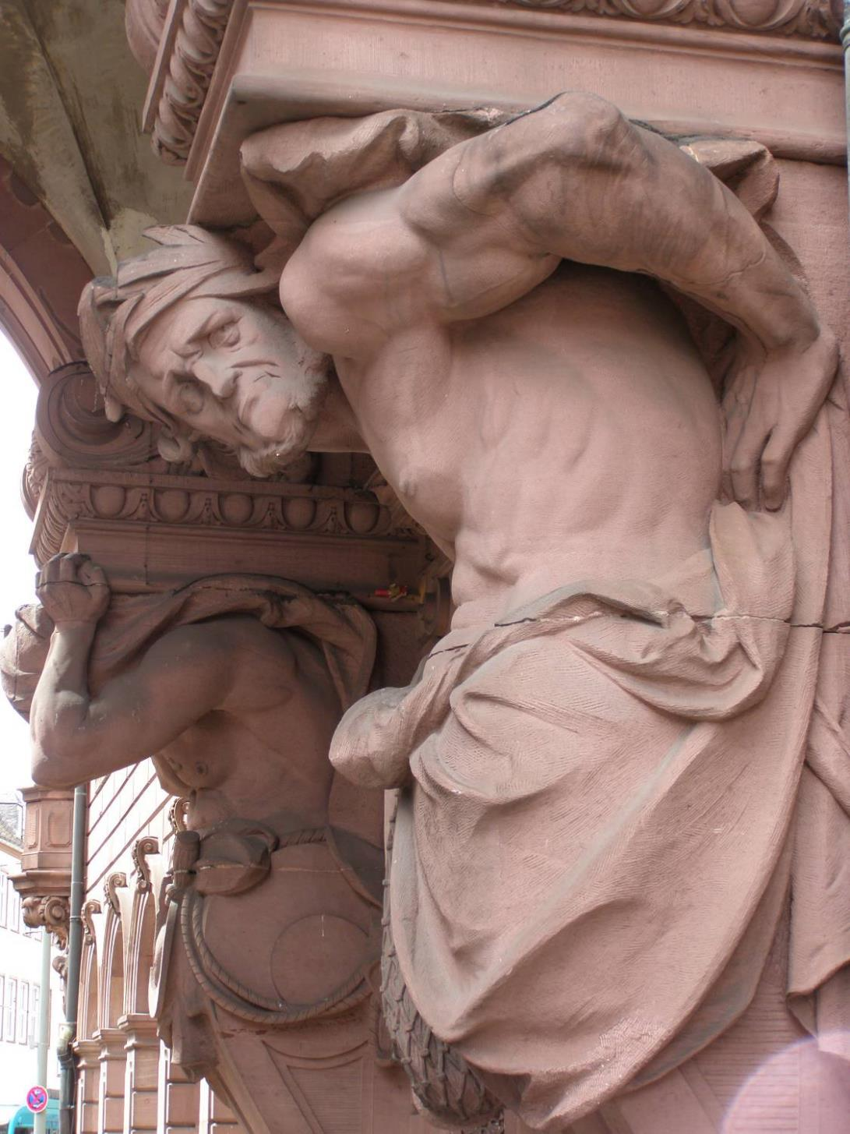
Other Initiatives

Slide 31
Other Initiatives
We are trying to use project management tools as well as micro-volunteering to make it easier for professional volunteers to help Region 6.
Region 6 has money available for local sections to host breakfasts or lunches with local industry leaders. In the Santa Clara Valley section they do this about once a quarter with about 30 companies participating
Create a Region 6 Industry Advisory Board
We are seeking IEEE Engineering Milestones in Region 6 and have a Region 6 Milestone coordinator who can help you with this process—Brian Berg, brianberg@gmail.com

Slide 32




Region 6 Conferences
WIE – May 23-24, 2016, Santa Clara
IEEE On-Line Career and Talent Expo (on-going)
GHTC – October 2016, Seattle, WA
SusTech –October 2016, Phoenix, AZ
Rising Stars—January 2017, Las Vegas
Creating a Conference Playbook to make running conferences easier
SUSTECH 2013
Women in Engineering
International Leadership Conference
1st I E E E Co n f e r e n c e o n T e c h n o l o g i e s f o r Su s t a i n a b i l i t y

Slide 33
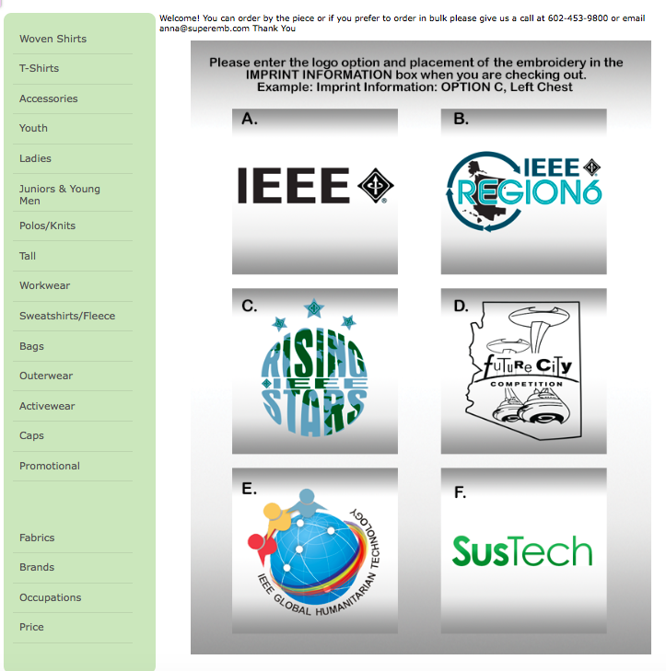

Buy Region 6 Gear

Slide 34


Your IEEE Resources
ieee.org
ieee-usa.org
ieee-region6.org
students.ieee-region6.org
http://ieee-region6.org/volunteer/

Slide 35
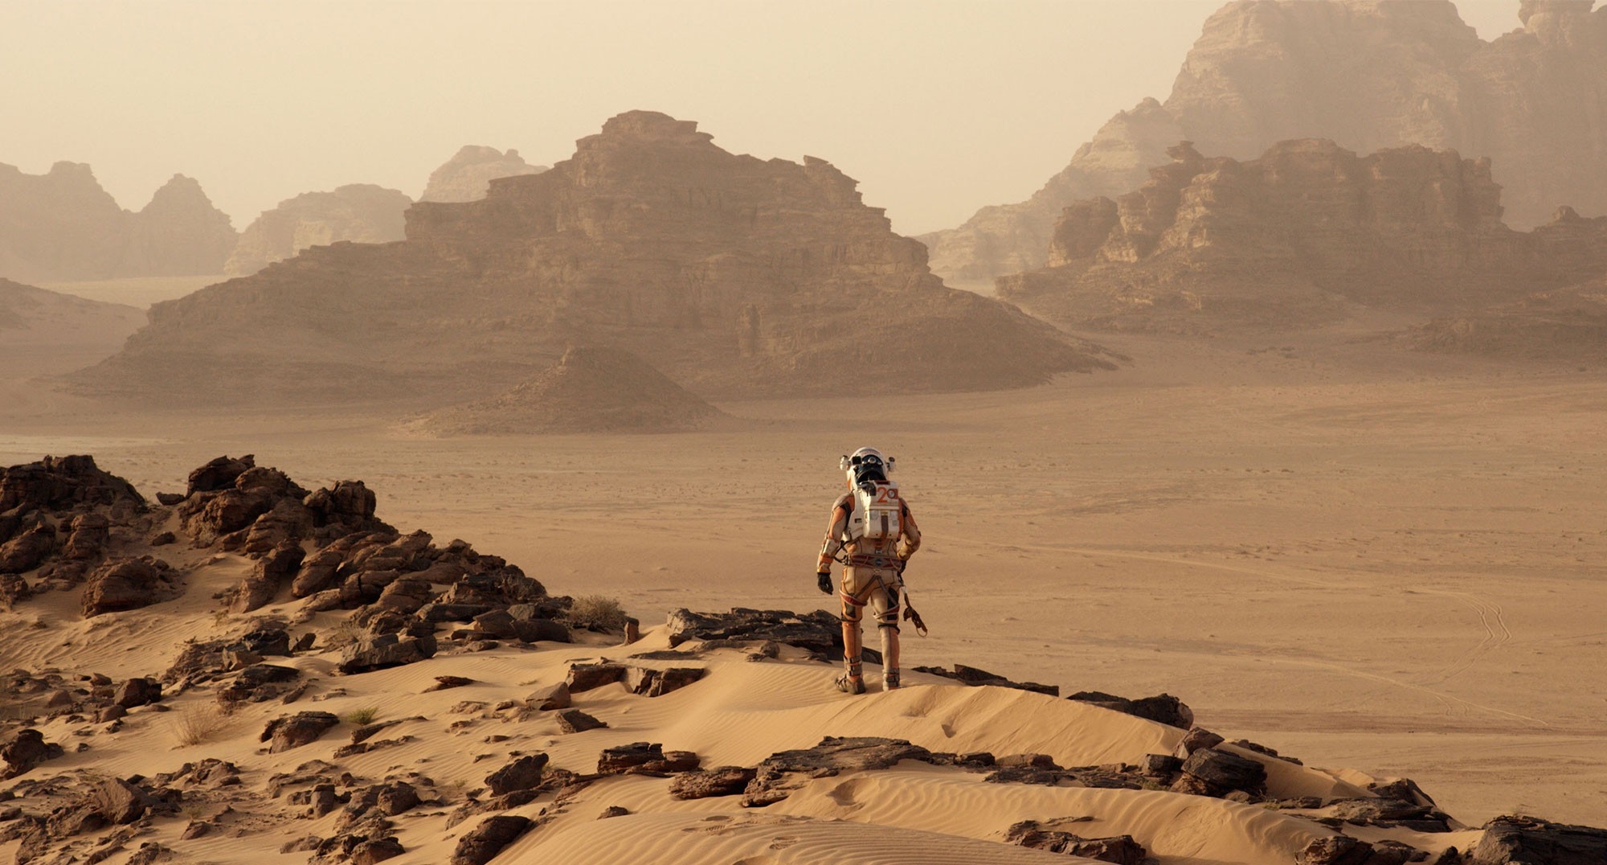
No Limits
∞

