Slide 1
Region 6
Conferences & Expos
R6 Excom - 5 November 2016
Ed Perkins
R6 Conferences Coordinator
e.perkins@ieee.org

Slide 2
R6 Conferences & Expos
GHTC – 6th year – Held Oct. 13-16
SusTech – 4th year – Held Oct. 9-11
Rising Stars – 3rd year - Jan. 2017
Career & Talent Expo – 2nd year
Virtual & Hybrid Events - developing
GHTC and SusTech are core to IEEE mission
3-5 years to establish sustainable event

Slide 3
SusTech 2016
Program
  81 submissions (17 withdrawn)
  79 registrants + keynotes and volunteers
  45 presented papers
  7 invited speakers
  3 keynotes
  5 panel
  7 workshop
  14 poster contestants

Slide 4
SusTech 2016
Authors
  147 authors, 16 countries
Region | Authors | %
United States | 72 | 49.0
Asia/Pacific | 26 | 17.7
Europe, Middle East, Africa | 21 | 14.3
Latin America | 19 | 12.9
Canada | 9 | 6.1
 | 147 | 100.0

Slide 5
SusTech 2016 – Finances (preliminary)
Income
  Registration: $29,395
  Sponsors: $12,500 + $1,500 (contest)
  Total Income $43,500
Expenses
  Hotel $30,500
  EDAS $ 950
  Marketing $ 1,600
  Misc $ 500
  Total Expense $33,300
Seed funding return to OUs $10,000
Balance $ 200

Slide 6
GHTC 2016
293 submissions (81 withdrawn)
167 papers accepted (132 published)
+278 registrations
149 presenters

Slide 7
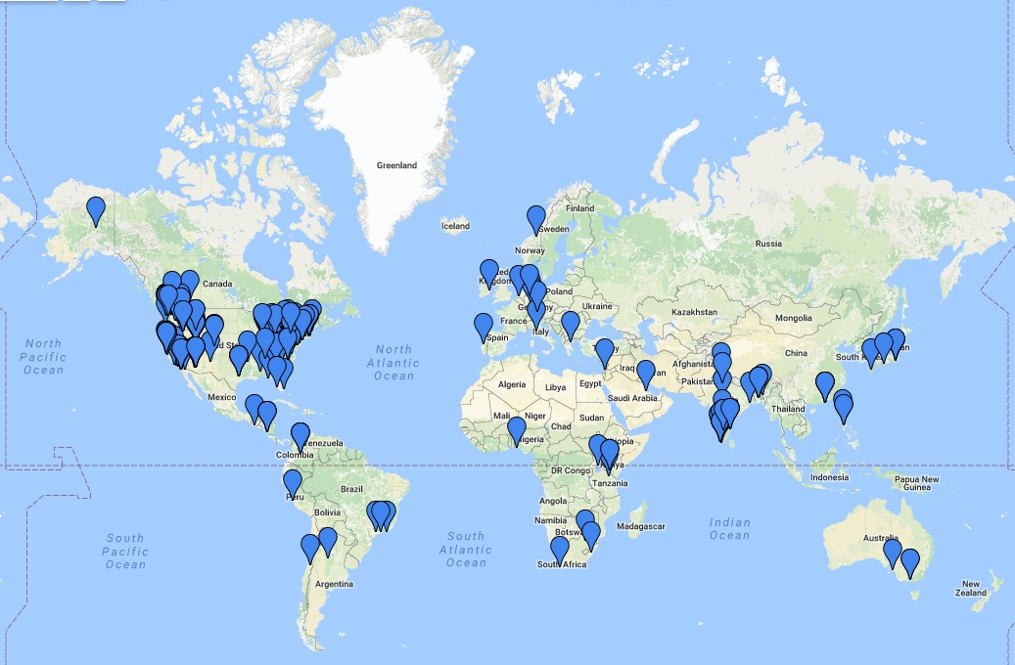
GHTC Attendees

Slide 8
GHTC 2016
Authors
578 authors, 37 countries
Region | Authors | %
United States | 239 | 41.3
Asia/Pacific | 208 | 36.0
Europe, Middle East, Africa | 82 | 14.2
Latin America | 45 | 7.8
Canada | 4 | 0.7
 | 578 | 100.0

Slide 9
GHTC Finances

Slide 10
Strategy
GHTC Strategy
  Flagship IEEE HT Conference – see IEEE tagline
  Focus on NGOs, Research, Practitioners, Funders
  Not use normal “conference model” (pay to publish)
  Initial concept – travel grants for NGOs et al
  Reliance on grants – IEEE, NASA, etc
  Initial concept of satellites to manage brand
SusTech Strategy
  Provide forum in IEEE for Sustainability
  Subtitle: Engineering and the Environment
  Focus on technologies and social implications
  Balance with invited as well as contributed sessions
  Build co-sponsors with IEEE and non-IEEE

Slide 11
Issues for Future
GHTC
  Funding – grants
  Participation – authors and practitioners
  Strength of program
  Recognition/relationship by HAC
  Ongoing leadership team
SusTech
  Build conference – authors, practitioners, partners, exhibits/patrons
  Expand co-sponsors (USA, SSIT)
  Build audience/attendance
  Ongoing leadership team

Slide 12
2017
GHTC – San Jose, Oct 19-22
  Advisory Committee
  Chair, Vice Chair, Treasurer
  Need to fill out key committee slots
  Need venue
  Need Timeline, MOU, TCS, CFP, ICX
SusTech – Phoenix
  Need to work on venue & date
  Need to fill key committee – chair, program
  Need Timeline, MOU, TCS, CFP, ICX

Slide 13
2018 and on
Ongoing management and support – the ‘institutional vision’ thing
Development lead time – need > 12 months
Siting/venue selection – time consuming
Chair selection – lack of bench
Program Chair selection - ditto
Track Chairs
Reviewers
Sponsors (e.g. TCS, FCS) – longer term
Patrons & Exhibitors – lead time; portfolio approach?
Advisory – need technical as well as ops advice

Slide 14
Conferences Futures
Develop R6 Conference Committee
Membership: Past chairs & future chairs
Address common issues for conferences
  Siting
  Venues
  Contracts
  Technical foci and consistency

Slide 15
Thank You.
Questions?

