Slide 1
PACE
Region 6 OpCom Meeting
Friday January 29, 2016
Region 6 PACE Chair: Mostafa Mortezaie
mortezaie@ieee.org

Slide 2
What is PACE?
(Professional Activities Committees for Engineers)
A network of IEEE volunteers and committees organized at the section and chapter levels with support from Regions and IEEE-USA.
PACE promotes:
  The professional interests of the U.S. members
  The professional activities within sections of the region and student branches.
  A mechanism for communication of members' views on their professional needs.

Slide 3
Five PACE Topics
Government Activities
Career and Employment Enhancement Activities
Pre-university (K-12 STEM) Activities
Student Professional Awareness Activities
Technical Policy Activities

Slide 4
Getting Started
Prepare a project plan
Identify resources and funding
Funding is available from multiple sources
Execute your project
Report the outcome of your project

Slide 5
PACE Project Ideas
Professional Development Seminars
S-PAX
Teacher-Engineer Partnerships
Future City Competition
FIRST Robotics Competitions
Lego Mindstorms

Slide 6
2015 Examples
Industry relations networking event
New members networking event
Entrepreneurship training
Distinguished lecturer presentation
Conduct resume and interview workshop
Creativity workshop
Building great website and handy vtools

Slide 7
Region 6 PACE Process
1. PACE request is sent to Region PACE Chair with approvals from the section representatives. Expediting measures have been acceptance of electronic signatures, scanned signatures, or email approval from the appropriate individuals.
2. PACE request is reviewed by Region PACE Chair for completion, applicability, approvals, etc. PACE request is either denied or recommended for approval. If denied, send reply email explaining why and what needs to be changed. If recommended for approval, send to Region Director and Region Treasurer with CC to requestor.
3. Region Director approves or rejects. If approved, Region PACE Chair add to spreadsheet of approved requests. Treasurer sends matching funds to the Section to oversee reimbursement.
4. Upon completion of the project the Section would send the PACE Final Report to PACE Chair.

Slide 8
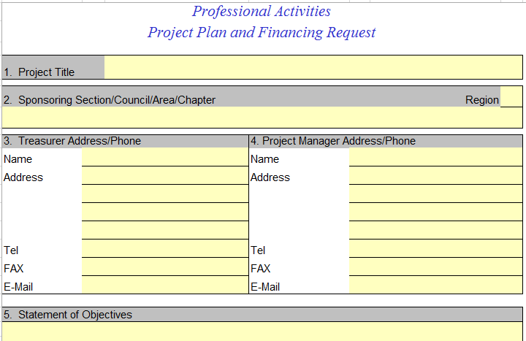
PACE Request Form

Slide 9
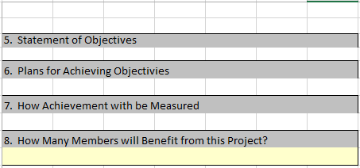
PACE Request Form (Continue)

Slide 10
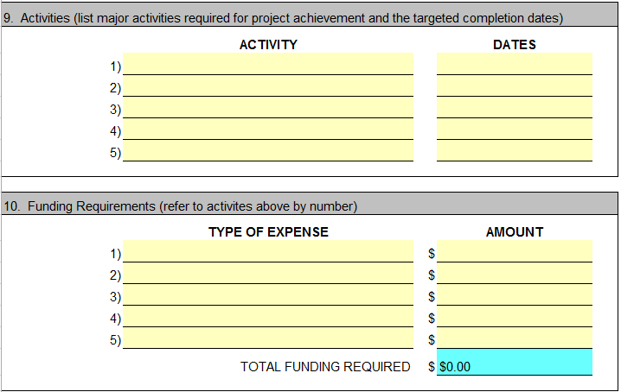
PACE Request Form (Continue)

Slide 11
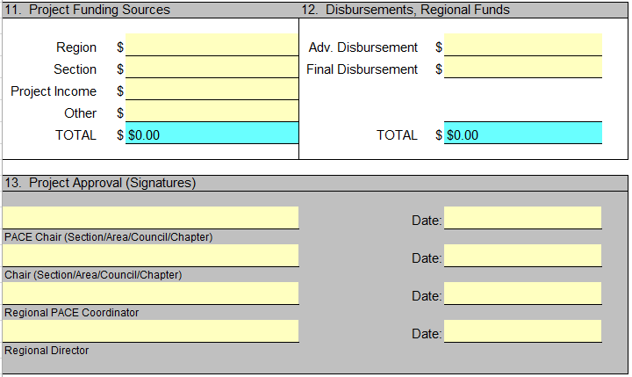
PACE Request Form (Continue)

Slide 12
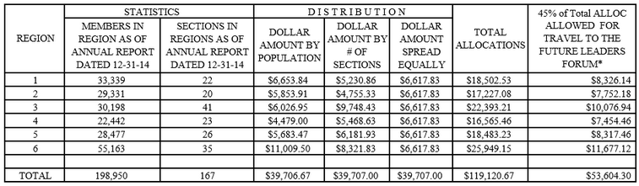
Professional Development Funds (PDF) Allocation breakdown for 2016

Slide 13
Future Leaders Forum
A Groundbreaking Opportunity for Learning, Growing and Networking
First-of-its-kind Future Leaders Forum focused on early career technology innovators, thinkers, students, and Young Professionals.
Where: New Orleans, LA
When: July 28-30, 2016

Slide 14

Future Leaders Forum

Slide 15
Future Leaders Forum (PACE Fund)
Funding requests shall go through:
Region PACE Chair (coordination with Region Student Activities Chair (RSAC) and Region Director Elect)
Regions will decide if attendees would be fully or partially funded.
Early Bird Fee Registration fee: $295
Three nights double occupancy lodging: $134 total
Transportation to New Orleans: Varies
The registration includes dinner on Thursday night on a riverboat cruise with New Orleans Jazz, Friday breakfast and lunch and dinner held at Mardi Gras World with a live band, and Saturday breakfast and lunch concluding with the Chris Washborne Jazz Band teaching improvisational leadership.
So registration and 3 nights lodging will be $429 plus travel costs. I suspect that individuals in July can keep their total expenses down to between $800-$900 total.

Slide 16
Questions/Comments

