Slide 1

IEEE Future Directions
Multi-Region Meeting
Tom Coughlin—Chair of CE Society Future Directions Committee
31 Jan 2016

Slide 2



Innovations Occur at Intersections
Technology, economics, society, sustainability
IEEE Future Directions serves IEEE at these technology intersections to lead innovation
Transportation Electrification
Cybersecurity
IoT
Smart
Cities
Smart
Materials
SDN
Green
ICT
Rebooting
Computing
Cloud
Computing
Life Sciences
Smart
Grid

Slide 3


Future Directions Committee
(FDC) Mission
Anticipates the direction of new and emerging technologies and world challenges that IEEE can impact
Coordinates resources across an unmatched array of IEEE technical expertise globally
Scouts out and nurtures ways IEEE as a whole can provide an impact through its broad and deep volunteer base
Bridges across IEEE Operating Units (OUs) to ride fast-rising waves of innovation
Provides a valuable collaborative view and fosters engagement, enabling IEEE OUs to develop new offerings
    FD website: ieee.org/futuredirections

Slide 4
FDC Charter
Anticipate and Determine the Direction of Existing, New and Emerging Technologies, and Related Issues, and Spearhead their Investigation and Development by IEEE
Act as Facilitator in transitioning Graduated Initiatives into operational entities
Technologies:
Big Data
Brain
Cyber-Security
Digital Senses
Green ICT
Internet of Things
Rebooting Computing
Software Defined Networks
Smart Materials
LV⁴
World Challenge:
“Growing Urbanization:
Smart Cities”
Smart Grid
Life Sciences
Cloud Computing
Transportation Electrification
LV⁴
: Leveraging Data Volume, Velocity, Variety to create Value

Slide 5
2015-2016 FDC Initiatives
Initiatives | Chair/Co-Chairs | Program Director
Big Data bigdata.ieee.org | David Belanger / Jose' Moura | Kathy Grise
Brain | Paul Sajda | Sin-Kuen Hawkins
Green ICT greenict.ieee.org | Jaafar Elmirghani / Thierry Klein | Andrew Hughes
Cyber Security cybersecurity.ieee.org | Rob Cunningham / Ulf Lindqvist | Brian Kirk
Digital Senses digitalsenses.ieee.org | Yu Yuan | Charlotte Kobert
Internet internetinitiative.ieee.org | Oleg Logvinov | Jim Wendorf
Internet of Things (IoT) iot.ieee.org | Roberto Minerva | Harold Tepper
Rebooting Computing rebootingcomputing.ieee.org | Elie Track / Tom Conte | Bichlien Hoang
Smart Cities smartcities.ieee.org | Gilles Betis | Harold Tepper
Software Defined Networks sdn.ieee.org | Antonio Manzalini / Eileen Healy | Tim Kostyk
Smart Materials | Geoff Brennecka | Kathy Grise

Slide 6

New Avenues for IEEE Innovations
Innovation is much more than technology
As we consider the broader aspects of innovation, we also extend the IEEE audience and marketplace
IEEE Future Directions events and programs expand IEEE’s presence beyond typical constituencies, helping establish IEEE as the venue for today’s & tomorrow’s brightest minds to work together
Join the innovation movement
ieee.org/futuredirections

Slide 7

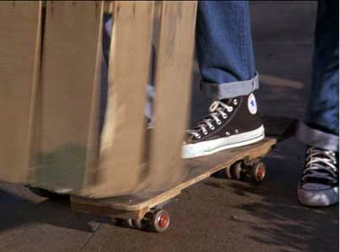
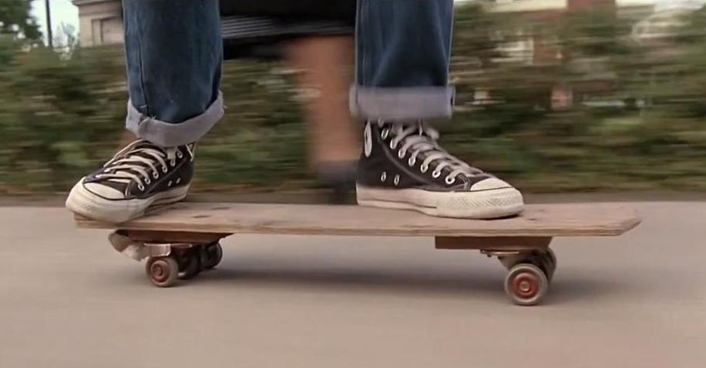
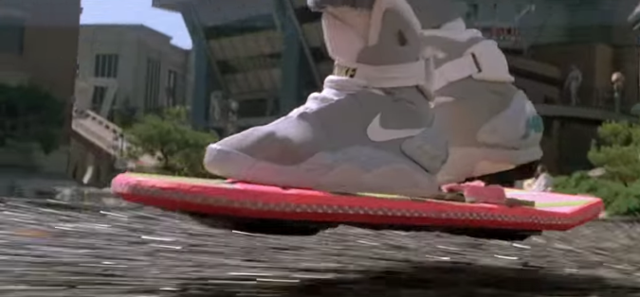
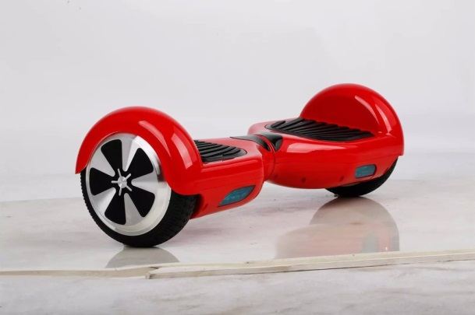
Learning from the Past, Current…
Thirty years ago…
Today…
Future?…

Slide 8
2015 Future Directions Committee
Voting Members
Roberto Saracco, FDC Chair, ICT Labs Italy Node Director
Steve Diamond, FDC Vice-Chair, EMC, Computer Society, Consumer Electronics Society
Clint Andrews, Rutgers University, Society for Social Implications of Technology
Thomas Coughlin, Coughlin Associates, Consumer Electronics Society
Pierre Dersin, Alstom Transport
Fabrizio Lombardi, Northeastern University, Computer Society
Raj Madhavan, Institute for Systems Research, Robotics and Automation Society
Francisco Martinez, Sistemas Azteca, SA, IEEE MGA
Roberto Minerva, Telecom Italia, Communications Society
Wanda Reder, S&C Electric Company, Power and Energy Society
Robby Robson, Eduworks, IEEE SA
Jon Rokne, Univ. of Calgary Dept. Of Computer Science, IEEE EAB
Devon Ryan, IEEE-USA
Elie Track, nVizix, Superconductivity Council
Gudrun Zahlmann, Roche Switerland, EMB Society
Doug Zuckermann, Telecordia Technologies (Retired), Communications Society
Staff Members
William Tonti, Senior Director, Future Directions
Bichlien Hoang, Senior Program Director, Future Directions
……

Slide 9

Future Directions Initiatives

Slide 10









FDC 2016 Initiatives
Smart Materials
Maturity Level
ieee.org/futuredirections

Slide 11






Web Portal
882,242 pageviews 2015 YTD
873,737 pageviews in 2014
2015 YTD number equals 101% of pageviews in 2014
Current & Graduated
IEEE Future Directions
Initiative Dashboard
28,771 followers
35,431 mentions
122.7 million impressions
9,741 unique Twitter users
49,584 TC members
53,513 newsletter subscribers
45,893 group members
25 webinars completed*
4,822 participants
7,702 on-demand downloads
*includes ECN Google Hangout
7,599 enrolled students
149 countries represented
Dashboard for January – October 2015
Notes:
2015 Initiatives:
Big Data
Cyber Security/Center for Secure Design
Green ICT
IoT
Rebooting Computing
Software Defined Networking
Smart Cities
Graduated Initiatives:
Smart Grid
Life Sciences
Cloud Computing
Transportation Electrification
Year to date numbers represent growth from January thru October.
Web portal
2015 YTD (Jan-Oct 2015) page view numbers reflect the current FD initiatives as noted above
2014 page views represents the same set of initiatives only (does not include Cloud Computing, Transportation Electrification, Life Sciences) The 2014 numbers are shown to provide perspective.
Twitter
YTD represents the growth from Jan thru October 2015
Followers: represents those following the 2015 IEEE FD twitter accounts
Mention: A Tweet including an IEEE FD @handle at any point other than the beginning of a tweet
Impression: The total number of times a Tweet from the IEEE FD account or mentioning your account could appear in users’ Twitter feeds during the report period. It includes FD Tweets, Tweets that mention your brand handles, and retweets of your content.
Twitter User: People that interact with IEEE Future Directions on Twitter
LinkedIn
Total number IEEE Future Directions Initiatives LinkedIn members for 2015 initiatives
Webinars
Participants: Those that dialed in for the live webinar
On-demand: Those that access the on demand webinar for viewing any time
The IEEE sponsored Google Hangout on ECN is included
Press
Articles published represents results based proactive outreach such as those contributed by subject matter experts or interviews that resulted in coverage
Media Impressions includes all media coverage that references the FD 2015 initiatives

Slide 12
FDC Incubators
FDC funding available for Societies, Councils, Graduated Initiatives, and other OUs
Process for proposal of new technology projects
  Requirements:
      Defined project scope
      Project plan and deliverables
      Request process open now
      Submission deadline through 1 June 2016
      Cannot be business as usual (e.g. Conferences, publications, DL’s, travel)
    Project paired with an FDC mentor
    Submission form on FDC portal: ieee.org/futuredirections
Notes:
Direct link. fix

Slide 13
2015 FDC Incubator Results
Society/Council | Topic
CES | Safe Advanced Mobile Power
CSC | Low Power Image Recognition Competition (LPIRC)
RS | An RS Tutorial Certificate Program on System and Software Reliability
MTT | The Internet of Space
PES | World Utility Summit
Notes:
Add more details

Slide 14
Future Directions Poll on New Initiatives
This Spring 2015 there was a poll of members of the IEEE Future Directions Committee on 9 future direction activities to start initiatives in 2015. Of these 2 were to be chosen
Power in Mobile Devices (A CE Society initiative) came in third with a ranking of 5.0, after Digital Senses (Hearing, sight, taste, smell, natural interfaces) with a ranking of 5.5 and Brain Machine Interface with a ranking of 14.0
Perhaps in 2016-2017 this mobile power initiative could become a major initiative of the IEEE Future Directions Committee

Slide 15
Mobile Power Initiative Objective
The objective of this effort is to create a safe and sustainable mobile energy source for a mobile device, such as a smartphone, that will supply a week’s worth of “normal” use without recharging from a fixed power source.
The creation of longer lasting energy sources for mobile devices will have important technical and social benefits
Can we create something like a “Moore’s Law” for mobile power?

Slide 16
Safe Advanced Mobile Power
This activity started in 2014 with funding from an IEEE Future Directions Seed Grant
Grant helped to fund two workshops on this topic in 2014 (one in San Jose, CA and the other in Galway, Ireland)
The 2014 workshops resulted in a white paper on this topic now on the CE Society FD webpage
New grant in 2015 was to fund two energy efficient student competitions to be held in conjunction with two workshops (one was in Silicon Valley and the other was a webinar)

Slide 17
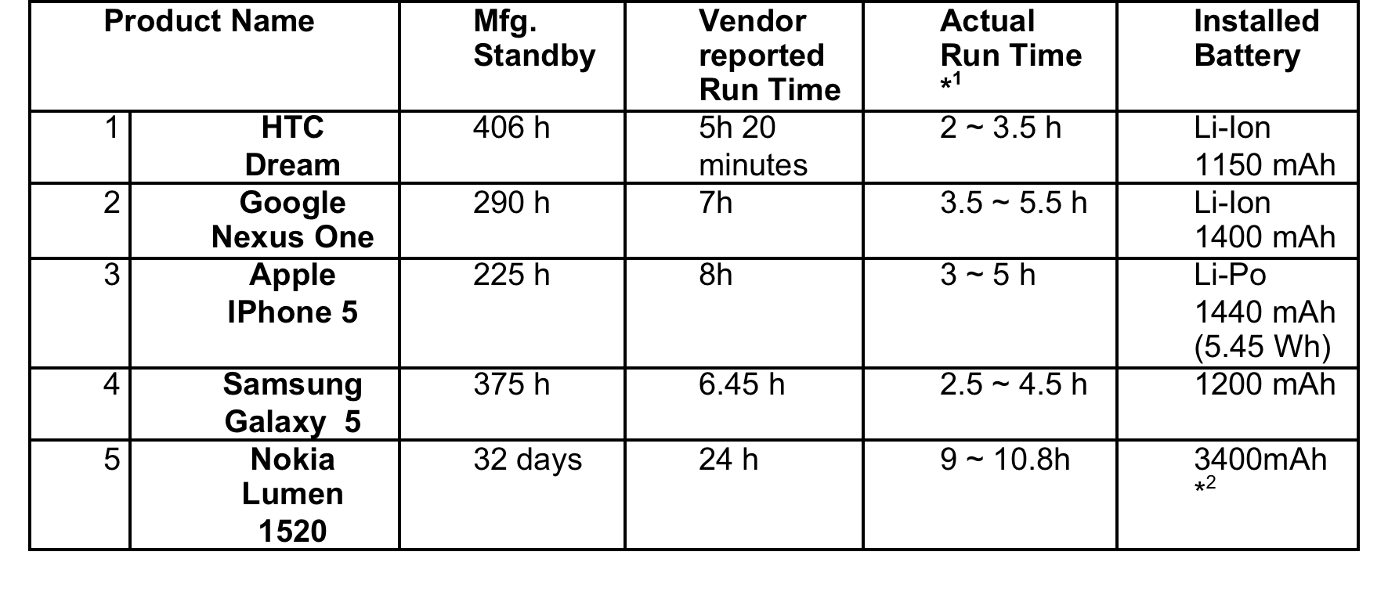
Rated and Actual Energy Use and Battery Energy Storage for Conventional Smart Phones

Slide 18
Casual Cell Phone User
The casual user might get 5 hours of use with a 1,400 mAh (1.4 Ah) battery.
If this was consistent across 7 days the total energy requirement is 7 X 1.4 Ah or 9.8 Ah.
Assuming this is a 3.7 V device then the actual energy used in a week is 9.8 Ah X 3.7 V = 36.3 Wh or 130,536 Joules.

Slide 19
Power Cell Phone User
12 hours of intense use with lots of radios running (Blue Tooth, WiFi, GPS and NFC), downloading lots of data and watching movies.
This user may consumer 1,400 mAh (1.4 Ah) in only 3 hours and actually want to consume 4 times more power in the day or 4 X 1.4 Ah = 5.6 Ah.
If this is a 3.7 V device the energy required for one day would be 5.6 Ah X 3.7V = 20.7 Wh.
A 7 day energy requirement for such a user would then be 7X20.7Wh = 145Wh or 522,144 Joules.

Slide 20



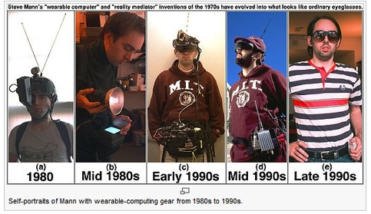
We Could Record our Lives

Slide 21
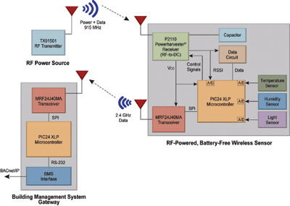
What Else We Could Do (2)
Provide wireless energy for battery-less wireless devices
Mobile phones could be the basis of edge networks for the IoTs
A system block diagram for a battery-less sensor system, RF energy harvesting and wireless power, Electronic Productions, August 2011

Slide 22
What Else We Could Do (3)
The phone could power external USB devices
Phones could be more useful for untethered WiFi hot spots
With more power, phones could have have more powerful computers and do more complex computations—computational imaging
We could do things we haven’t even dreamed of yet

Slide 23
Tech Policy / Ethics in FD Initiatives
Incorporate in 2016 a Tech Policy / Ethics Project into each FDC Initiative
  FDC needs your help to define policy and ethics projects that align with the technology and investigate policies/ethical issues that will affect the technology
  Possible considerations?
    Organize an IEEE ethics conference
    Host tech policy/ethics panels at existing IEEE events
Involve
  Societies, Councils, Graduated Initiatives, and all OUs
Notes:
SSIT and TMS presidents… emails.

Slide 24

Cybersecurity Initiative
Rob Cunningham, Chair; Ulf Lindqvist, Vice Chair
Brian Kirk, Program Director, bkirk@computer.org
2015 Milestones
2016 Plans
Onset of Try-Cybsi
Phase II of Try-Cybsi
  Test Phase I deliverables
  Build out modules to include CSD design recommendations
Expand Building Code work
  Initial outreach to IEEE Smart Grid and PES
  Working on next areas for Building Code
Revisit Top 10 Flaws
    - Expand European involvement
Notes:
Fix emails.

Slide 25

Internet of Things (IoT) Initiative
Roberto Minerva, Chair
Harold Tepper, Senior Program Director, h.tepper@ieee.org
2015 Milestones
WF-IoT 2015
  Conference in Milan, Italy
Launch IEEE IoT Newsletter
Community Development
  IEEE TC: 9,800+ members; 3500+ increase
  Twitter: 6,000+ followers; 500%+ increase
  LinkedIn: 3,500+ members; triple digit increase since inception
  Launched IoT Collabratec Community
2016 Plans
Transition plan
Develop a series of
eLearning modules on IoT
Increase engagement with and linkages to Industry

Slide 26
Internet of Things (IoT)
Extending the current Internet and providing connection, communication, and inter-networking between devices and physical objects, or "Things," is a growing trend that is often referred to as the Internet of Things.
“The technologies and solutions that enable integration of real world data and services into the current information networking technologies are often described under the umbrella term of the Internet of Things (IoT)”

Slide 27
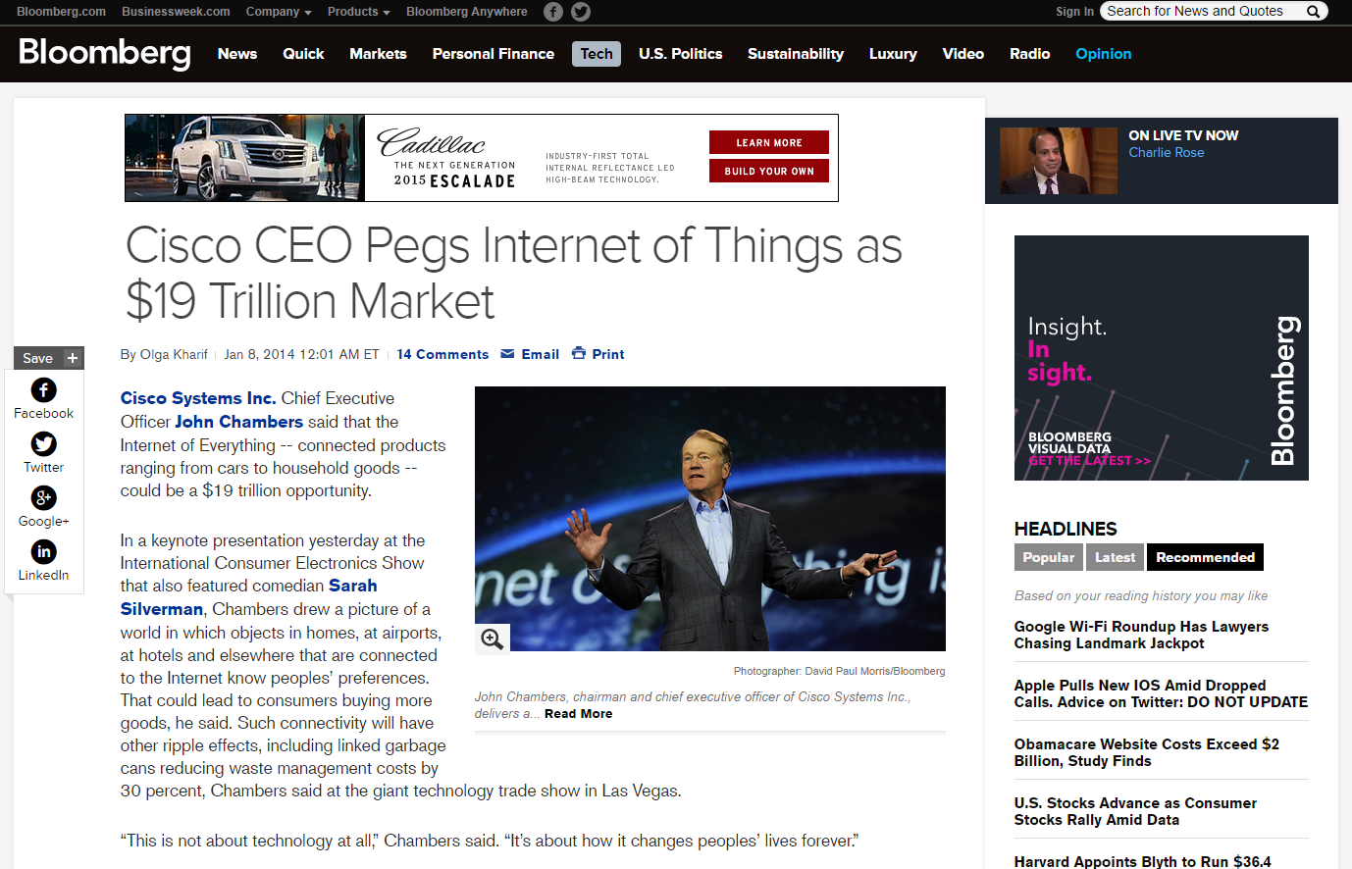
The Potential of the IoT Market
27
Notes:
IEEE E-Learning Library is comprised of more than 65 one-hour interactive online courses in IEEE’s technical areas of interest.
Subscriptions are available for Corporate, University, Government and Individual Members. Participants can earn continuing education units and professional development hours.
The IEEE Education Partners Program offers online courses from university and corporate institutions at a discount.
IEEE also offers several skills certifications. These include the IEEE Computer Society Certified Software Development Professional Program and the Wireless Communications Engineering Technology Certification Program from the IEEE Communications Society.
IEEE Pre-University Programs connect engineers and educators. The Pre-University Teacher In-Service Program (TISP) for Sections features IEEE volunteers developing and presenting technical subject matter to pre-university educators in a professional development setting.
Tryengineering.org is a Web site for engineering and engineering education for counselors, teachers, parents and students. It is a joint project of IEEE, IBM and the New York Hall of Science.
IEEE also is responsible for carrying out the accreditation process for U.S engineering and engineering technology programs. IEEE also participates in international accreditation activities.

Slide 28
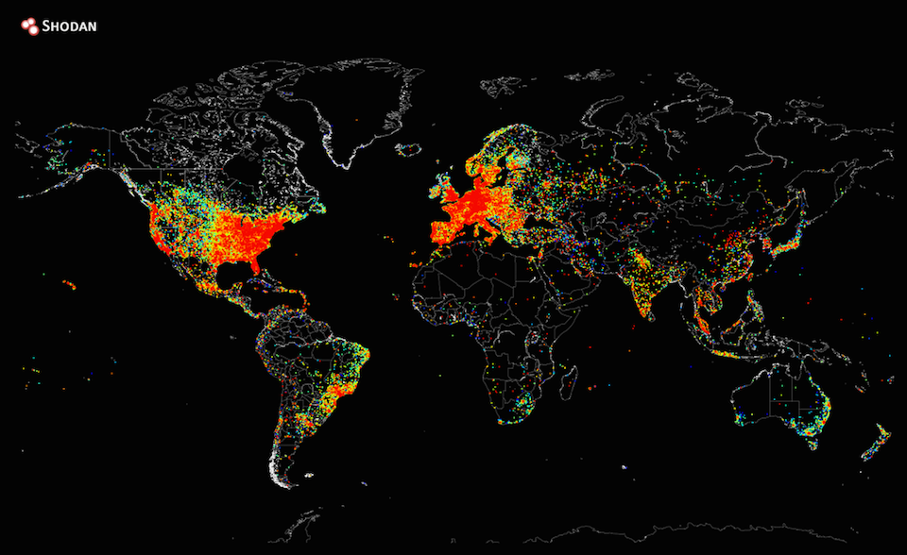
A Map of every Connected Device on Earth
28
Notes:
IEEE E-Learning Library is comprised of more than 65 one-hour interactive online courses in IEEE’s technical areas of interest.
Subscriptions are available for Corporate, University, Government and Individual Members. Participants can earn continuing education units and professional development hours.
The IEEE Education Partners Program offers online courses from university and corporate institutions at a discount.
IEEE also offers several skills certifications. These include the IEEE Computer Society Certified Software Development Professional Program and the Wireless Communications Engineering Technology Certification Program from the IEEE Communications Society.
IEEE Pre-University Programs connect engineers and educators. The Pre-University Teacher In-Service Program (TISP) for Sections features IEEE volunteers developing and presenting technical subject matter to pre-university educators in a professional development setting.
Tryengineering.org is a Web site for engineering and engineering education for counselors, teachers, parents and students. It is a joint project of IEEE, IBM and the New York Hall of Science.
IEEE also is responsible for carrying out the accreditation process for U.S engineering and engineering technology programs. IEEE also participates in international accreditation activities.

Slide 29
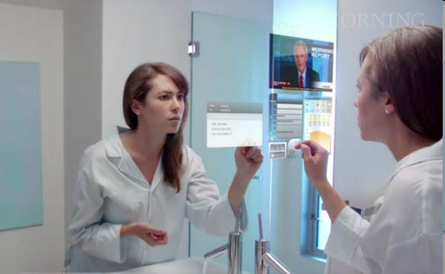
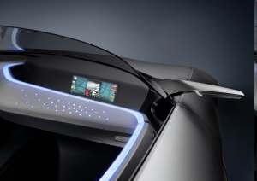

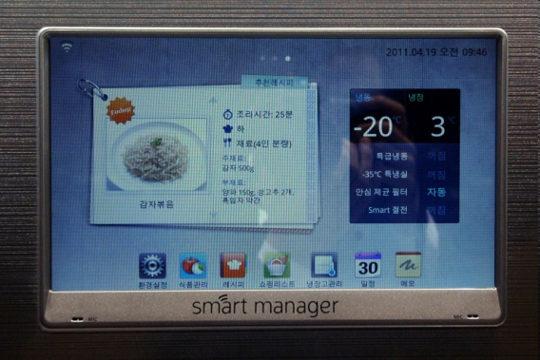

More “Things” are being connected
More “Things” are being connected
Home/daily-life devices
Business and
Public infrastructure
Health-care
…

Slide 30








People Connecting to Things
ECG sensor
Internet
Motion sensor
Motion sensor
Motion sensor

Slide 31
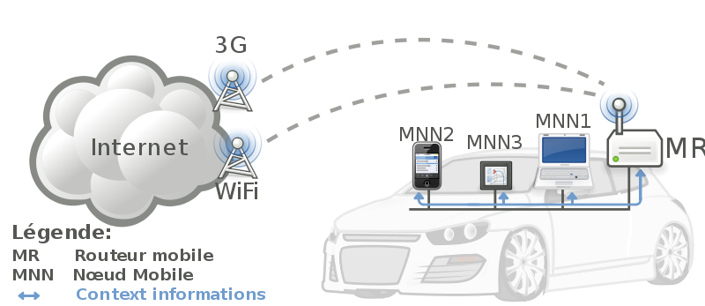





Things Connecting to Things
- Complex and heterogeneous
resources and networks

Slide 32







Wireless Sensor Networks (WSN)
End-user
Core network
e.g. Internet
Gateway
Sink
node
Gateway
Computer services
The networks typically run Low Power Devices
Consist of one or more sensors, could be different type of sensors (or actuators)

Slide 33
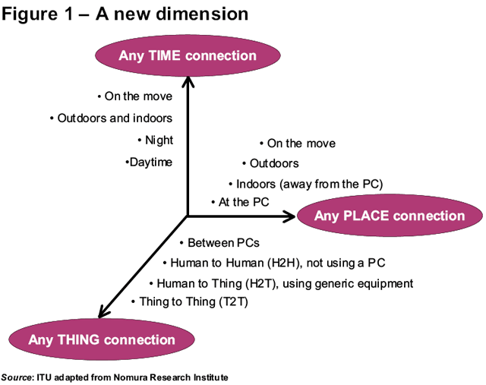
Future Networks
33
33

Slide 34
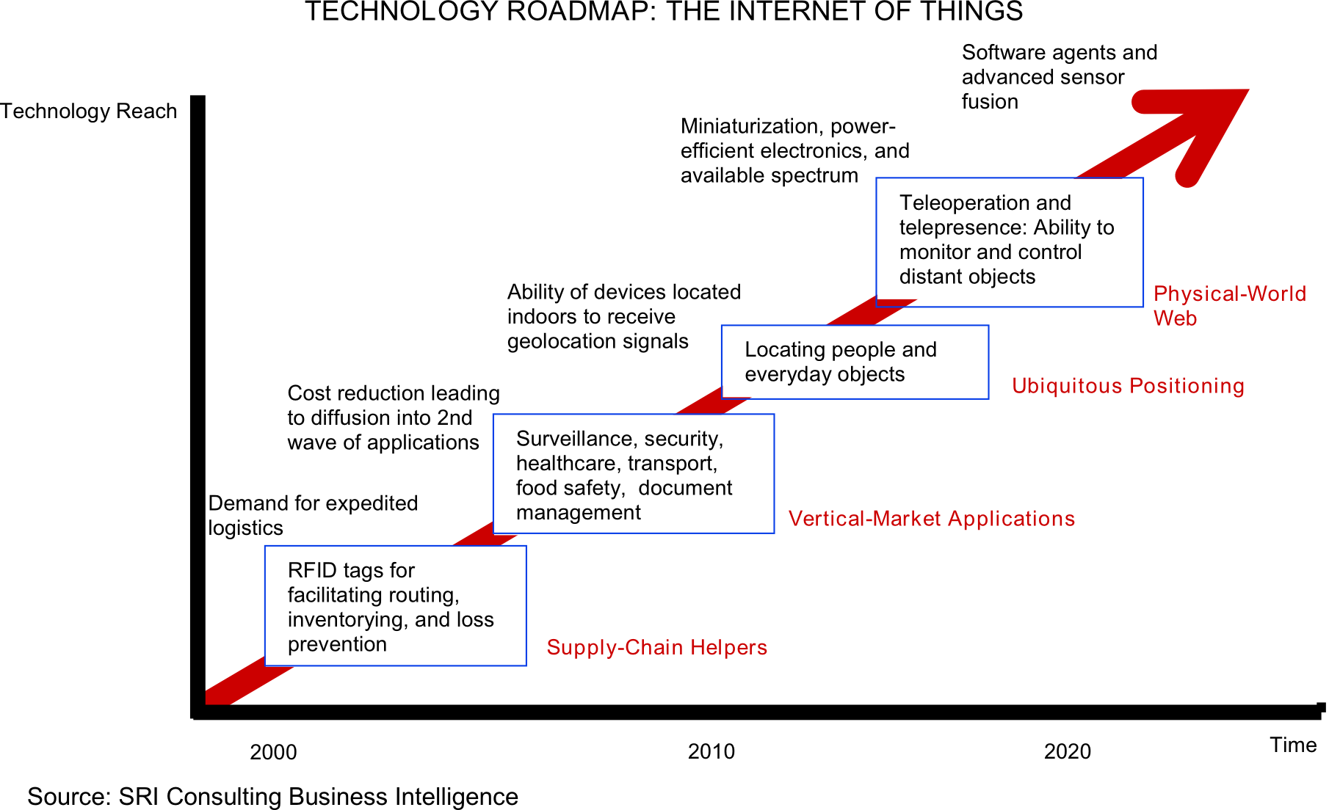
Technology trend

Slide 35
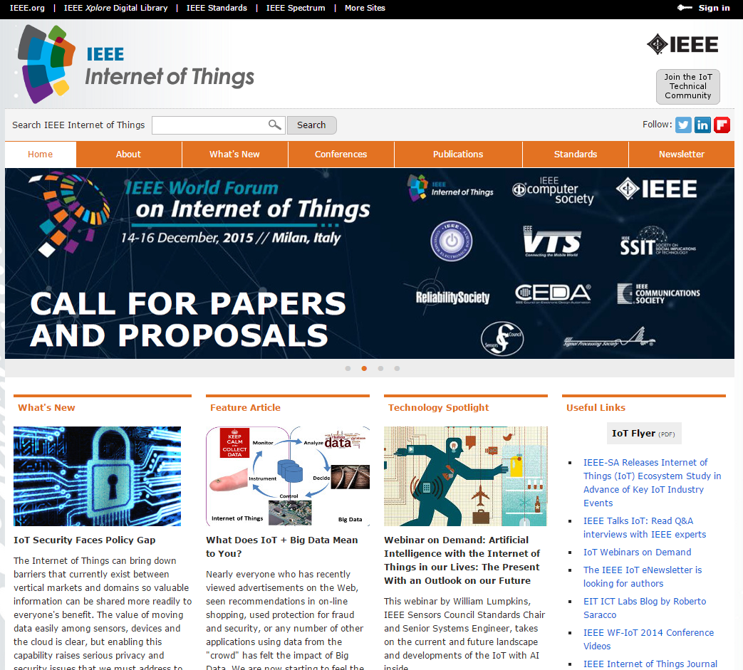
The IEEE IoT Web Portal
http://iot.ieee.org
35
Notes:
IEEE E-Learning Library is comprised of more than 65 one-hour interactive online courses in IEEE’s technical areas of interest.
Subscriptions are available for Corporate, University, Government and Individual Members. Participants can earn continuing education units and professional development hours.
The IEEE Education Partners Program offers online courses from university and corporate institutions at a discount.
IEEE also offers several skills certifications. These include the IEEE Computer Society Certified Software Development Professional Program and the Wireless Communications Engineering Technology Certification Program from the IEEE Communications Society.
IEEE Pre-University Programs connect engineers and educators. The Pre-University Teacher In-Service Program (TISP) for Sections features IEEE volunteers developing and presenting technical subject matter to pre-university educators in a professional development setting.
Tryengineering.org is a Web site for engineering and engineering education for counselors, teachers, parents and students. It is a joint project of IEEE, IBM and the New York Hall of Science.
IEEE also is responsible for carrying out the accreditation process for U.S engineering and engineering technology programs. IEEE also participates in international accreditation activities.

Slide 36
For More Information
The IEEE www.ieee.org
IEEE Internet of Things Initiative http://iot.ieee.org
IEEE Internet of Things on Linkedin https://www.linkedin.com/groups?mostRecent=&gid=5148323&trk=my_groups-tile-flipgrp
IEEE Internet of Things on Flipboard https://flipboard.com/@stogner/ieee-internet-of-things-rsqdr8tjy
IEEE Internet of Things on Twitter @IEEEIoT
IEEE Consumer Electronics Society http://cesoc.ieee.org/
IEEE Standards Association http://standards.ieee.org/
IEEE Xplore Digital Library http://ieeexplore.ieee.org/Xplore/home.jsp
36
Notes:
IEEE E-Learning Library is comprised of more than 65 one-hour interactive online courses in IEEE’s technical areas of interest.
Subscriptions are available for Corporate, University, Government and Individual Members. Participants can earn continuing education units and professional development hours.
The IEEE Education Partners Program offers online courses from university and corporate institutions at a discount.
IEEE also offers several skills certifications. These include the IEEE Computer Society Certified Software Development Professional Program and the Wireless Communications Engineering Technology Certification Program from the IEEE Communications Society.
IEEE Pre-University Programs connect engineers and educators. The Pre-University Teacher In-Service Program (TISP) for Sections features IEEE volunteers developing and presenting technical subject matter to pre-university educators in a professional development setting.
Tryengineering.org is a Web site for engineering and engineering education for counselors, teachers, parents and students. It is a joint project of IEEE, IBM and the New York Hall of Science.
IEEE also is responsible for carrying out the accreditation process for U.S engineering and engineering technology programs. IEEE also participates in international accreditation activities.

Slide 37

Rebooting Computing Initiative
Tom Conte and Elie Track, Co-Chairs
Bichlien Hoang, Senior Program Director, b.hoang@ieee.org
2015 Milestones
2016 Plans
1st Low Power Image Recognition Challenge
MOU signed with ITRS (International Roadmap for Semiconductors)
Rebooting Computing Summit 4
IEEE/ITRS Roadmap of Computer Performance
Work with IEEE-SA towards new Standards for technology development of benchmarking computer performance
new RC Conference (series)

Slide 38
IEEE Digital Senses Initiative
Digital Senses: Sight, Hearing, Touch, Smell, and Taste
One of the two new major initiatives selected by TAB/FDC
  Funded by TAB
  Led by CE Society (Yu Yuan)
  Other Societies/Councils will be invited to join
Project plan in 2015
  Set up the identity
    Logo, website, community, press release, etc.
    Biweekly teleconferences
  Build visibility
    Invited speeches or sessions at existing conferences (especially the big ones and those in conjunction with big shows)
  Solicit participation
    Round-table, problem-solving workshops in cities where relevant industries and expertise exist
  Collaborate with other ongoing efforts
    Augmented Reality (IEEE-SA, IEEE CS, IEEE CESoc, AugmentedReality.org, AREA, AR Community, etc.)
    Wearables (IEEE ComSoc, IEEE-SA, IEEE CESoc, CWCISA, etc.)
    Healthcare (IEEE EMBS, IEEE CESoc, IEEE-SA, IEEE Biometrics Council, SIBET, etc.)
    And more...
© 2015 Tom Coughlin for IEEE CE Society

Slide 39
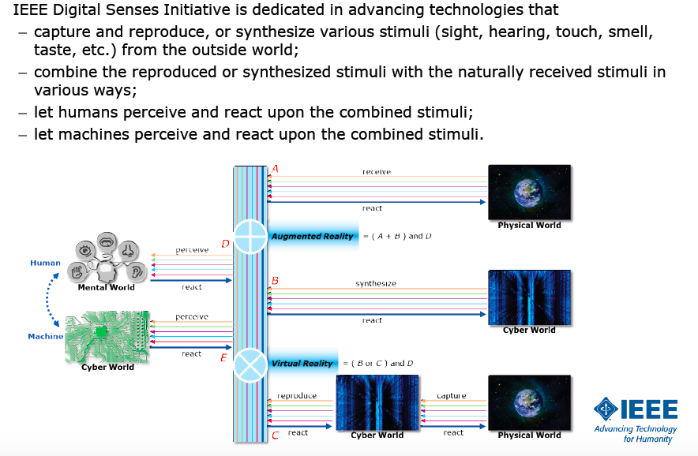
IEEE Digital Senses Initiative Scope

Slide 40
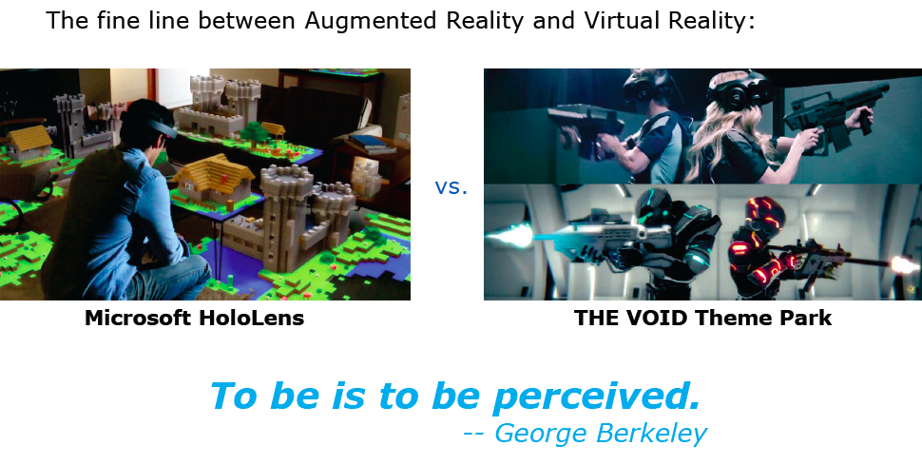
Augmented Reality/Virtual Reality

Slide 41
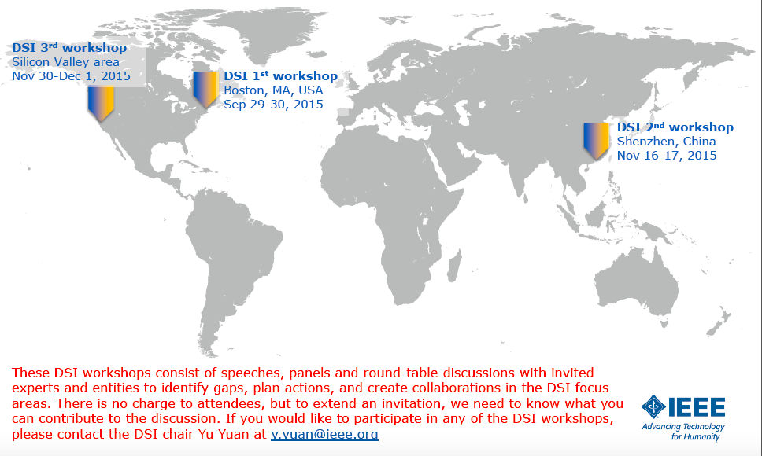
2015 DSI Workshops

Slide 42

Smart Cities Initiative
Gilles Betis, Initiative Chair
Harold Tepper, Senior Program Director, h.tepper@ieee.org
2015 Milestones
2016 Plans
1st Smart Cities Conference in Guadalajara
1st IEEE Smart Cities MOOC on edX
  Introduction to Metrics for Smart Cities
  7,600+ students from 150 countries registered
Selection of two new Core Cities
– Casablanca, Morocco
- Kansas City MO, USA
Growth of Affiliated Cities
MOOCs
and White Papers
Cities Use Cases &
Collaborative Actions
Explore consulting domain

Slide 43

SDN Initiative
Antonio Manzalini Initiative Chair
Tim Kostyk, Program Director, t.kostyk@ieee.org
2015 Milestones
2016 Plans
PreIndustrialization Workshop Nov 16 “Mobile Edge Cloud”
Publications: Communication Special Edition on SDN, Launched IEEE Softwarization eNewsletter, LOI for SDN Publication SDN Draft, SDN Blog established
    Standards Workshop June 2015
    4 study groups formed: (Security, Reliability and Performance study group; 2nd study group formed under NGSON project; Software Defined and Virtualized Wireless Access Research Group, Structured Abstraction Research Group
Develop Open Source Test Beds
IEEE Transactions on Network and Service Softwarization (TNSS)
NetSoft 2016
43

Slide 44

IEEE Big Data Initiative
David Belanger and Jose’ Moura, Co-Chairs
Kathy Grise, Senior Program Director, k.l.grise@ieee.org
2015 Milestones
Data repository & analytics
  Data repository requirements and spec definition for a data portal by year end
  Organized series of analytics applications competitions at Society conferences for 2016
Standards
  Held first standards workshop (BDISW) 2 November, at NIST, co-located with Reliability Society’s ISSRE
2016 Plans
Data repository & analytics
  Hold analytics applications competitions
  Design and develop
  Data repository prototype(s)
  Launch eNewsletter

Slide 45

IEEE Technology Time Machine

Slide 46



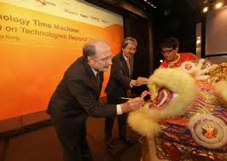
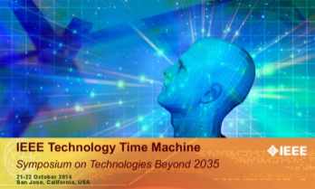
IEEE Technology Time Machine (TTM)
An IEEE Future Directions Symposium dedicated to future technologies and their impact on humanity.
Theme: Making the Future
Keynote speaker: Sherry Turkle, Alicia Abella
Distinguished Experts Panel
Invited speakers from industry, government, academia across Big Data, Brain, Cybersecurity, Digital Senses, IoT, Rebooting Computing

Slide 47




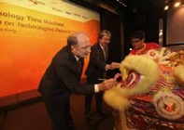
IEEE Technology Time Machine Update (ttm.ieee.org)
An IEEE Future Directions Symposium dedicated to
future technologies and their impact on humanity.
Leadership Team
Doug Zuckerman (General Chair)
Mahmoud Daneshmand (Program Chair)
John Barr (Treasurer)
Celia Desmond (DEP Chair)
Save the Date
20-21 October 2016
Hilton San Diego Resort & Spa
Framework
Theme: Making the Future
Two days, single track
~150 attendees
Partnering with San Diego chapter, Region 6, & Initiatives
Mini-TTMs to promote TTM
Preliminary Program
Keynote speakers: Hossein Eslambolchi and Sherry Turkle
Invited speakers from
  Big data
  Brain
  Cybersecurity
  Digital Senses
  IoT
  Rebooting Computing
Distinguished Experts Panel
Notes:
Hyperlink Hossein and Sherry’s bios.
Several mini-TTMs organized to promote in advance TTM 2016, ICCE, CCNC, and more.
Hossein Eslambolchi and Sherry Turkle. Hossein is a former president of AT&T Labs, written books, has a future-looking perspective of industry on telecommunications, computers, and networks, and has his own successful company. Sherry is a renowned professor at MIT, written books on the psychology of the internet and its impact on people, been in Business Week, and has been interviewed on network television.
The Big data, Brain, Cybersecurity, IoT, Rebooting Computing initiatives accepted to organize and secure speakers.
Sourcing for the Distinguished Experts Panel (DEP) potentially from include digital senses, mobile power, cloud computing.

Slide 48
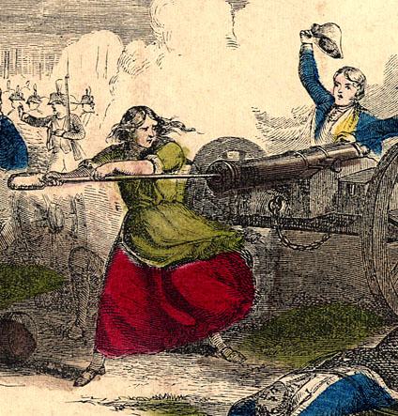
A Call to Action!
We encourage you to join our Future Directions activities
You can join a current committee, create a new committee and/or recruit folks to participate in our committees.
There are many consumer trends that we are not yet involved in
If you have an interest in one of the current committees or in helping create another committee let us know.
  Tom Coughlin, tom@tomcoughlin.com

Slide 49
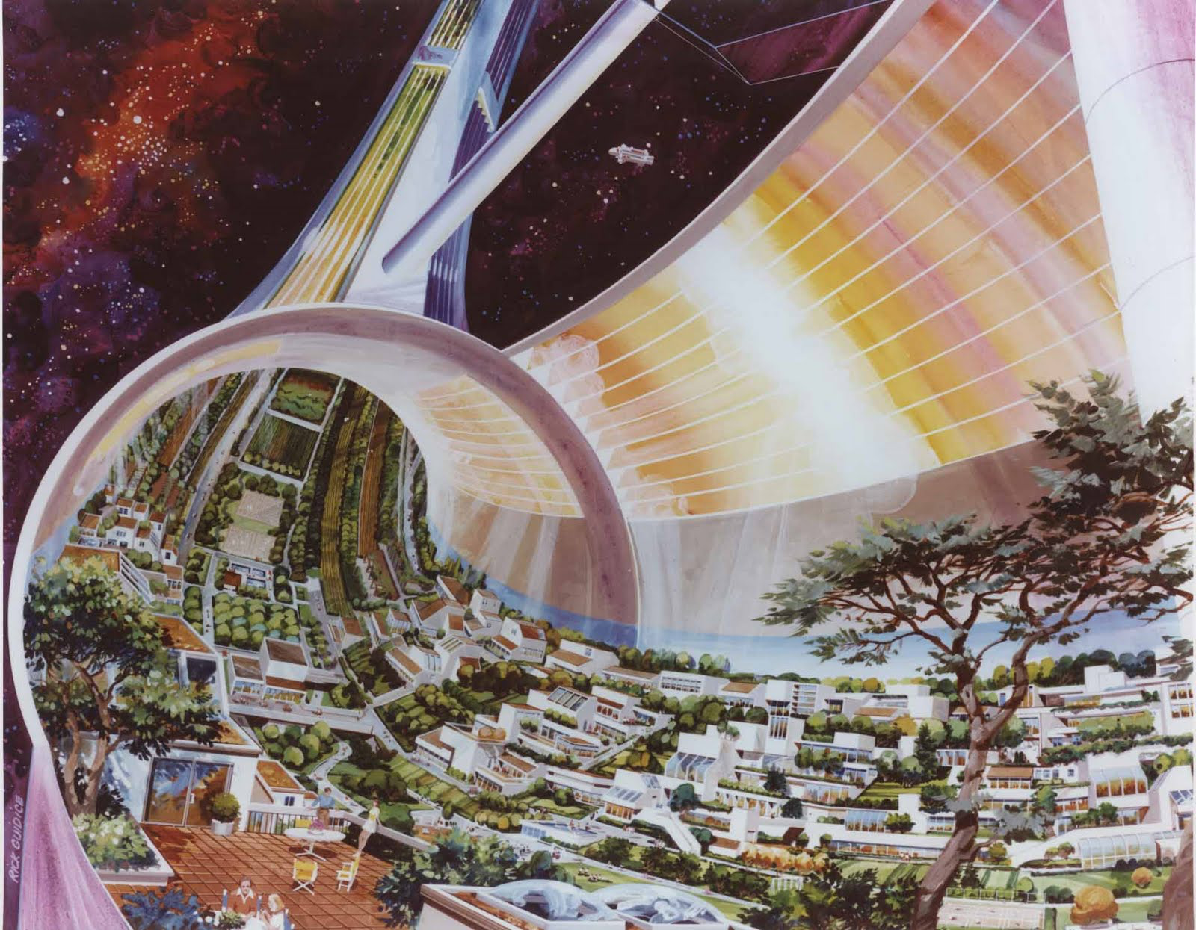
Let’s Create the Future

Slide 50

Thanks

Slide 51
Backup
Initiative milestones and 2016 plan

Slide 52
Cyberscurity Initiative
Rob Cunningham, Chair; Ulf Lindqvist, Vice Chair
Brian Kirk, Program Director, bkirk@computer.org
2015 Milestones
2016 Plans
23 media mentions
March 2015 special issue of The Institute on Cybersecurity
Building Code for Medical Device Software Security
  Initial Document designed and produced
  Presented at DHS meeting and mHealth Summit with Rock Stars event
2 Mini-Workshops completed with Center for Secure Design
  Wearable Tracking and Fitness
  Web Application Security
Refined existing website design
Onset of Try-Cybsi work with team at Purdue Polytechnic
Expanded existing Steering Committee and Advisory Board
Become the go-to online presence for Cybersecurity
  Expandable/adaptable web design
  Monthly outreach plan
  Weekly Q&A series
  Coordinate with 3I on security and privacy policy
Increase participation of existing IEEE intellectual property
Refine existing Center for Secure Design work
  Revisit Top 10 Flaws
  Expand European involvement
Phase II of Try-Cybsi
  Test Phase I deliverables
  Build out modules to include CSD design recommendations
Expand Building Code work
  Initial outreach to IEEE Smart Grid and PES
  Working on next areas for Building Code
Improve Security and Privacy Knowledge Base for Students and Professors
  Establish a series of Cybersecurity challenge problems
  Leverage selected ones for a problem of the month
Notes:
Fix emails.

Slide 53

Green ICT Initiative
Jaafar Elmirghani and Charles Despins, Co-Chairs
Andrew Hughes, Program Director, andrew.hughes@ieee.org
2015 Milestones
Diverse Steering Committee representing academia, industry & several Societies formed
Standards Gap Analysis Workshop to prepare plans for 2016 (next week!)
JSAC Green Sections – large number of high quality papers submitted for 2 calls for papers
Successful logo creation competition
~ 3400 Technical Community members
IEEE Events – contributed content, panels & speakers to seventeen events
Sent contributors to Big Data Initiative standards workshop
Drafted Sustainable ICT Magazine proposal
GreenICT.ieee.org portal launched
2016 Plans
Establish and support standards research groups, study groups, working groups based on plan from 2015
Collaborate with IEEE Societies, Councils and Organizational Units to establish Green ICT as a top-of-mind subject
Engage additional IEEE Societies, Councils and Organizational Units through conferences, standards development, Technical Community, webinars, Distinguished Lectures
Develop products in various Societies, thus yielding the approach for a sustainable bottom-line impact beyond the exit of the initiative after year 3.
Incubate & develop publications products; continue to build high value repository

Slide 54
Internet of Things (IoT) Initiative
Roberto Minerva, Chair
Harold Tepper, Senior Program Director, h.tepper@ieee.org
2015 Milestones
WF-IoT 2015 Conference in Milan, Italy
  Vint Cerf Keynote
IoT Start-up Events – Las Vegas, San Jose, Tel Aviv, Grenoble, NYC and Milan
IEEE IoT Newsletter
  7 issues, 28 articles; 9,600+ subscribers
37 IEEE IoT Expert Bylines, Blogs & Articles
  Total Media Impressions: 21,000+
7 IoT Webinars/Hangouts
  ~3,000 live and on-demand viewers
Community Development
  IEEE TC: 9,800+ members; 3500+ increase
  Twitter: 6,000+ followers; 500%+ increase
  LinkedIn: 3,500+ members; triple digit increase since inception
  Launched IoT Collabratec Community
2016 Plans
Develop and implement plan to transition the IoT Initiative to the IEEE Infrastructure
Develop a series of eLearning modules on IoT
Increase engagement with and linkages to Industry
Conduct WF-IoT 2016 Conference in Reston, Virginia
Secure support to develop an IoT Magazine
Implement a virtual conference based on WF-IoT 2015 Milan
Conduct 4 IoT Start-up events
Grow membership, visibility and influence through Social Media channels including Twitter, LinkedIn, Collabratec & Flipboard
Conduct collaborative events to disseminate content -- Webinars, Google Hangouts, etc.

Slide 55
Rebooting Computing Initiative
Tom Conte and Elie Track, Co-Chairs
Bichlien Hoang, Senior Program Director, b.hoang@ieee.org
2015 Milestones
2016 Plans
1st Low Power Image Recognition Challenge (LPIRC) at DAC 2015 (San Francisco, CA, June)
  Prizes awarded to 2 winning teams among 10 international participating teams
  Led to Special Session at ICCAD 2015 (November) and presentation at Embedded Vision Alliance Conference (October)
MOU signed with ITRS (International Roadmap for Semiconductors)
  2 joint workshops in February and July
Press Release to support National Strategic Computing Initiative (NSCI)- July
White Paper in response to OSTP Nanotechnology-Inspired Grand Challenge - October
Rebooting Computing Summit 4 (RCS 4) 9-11 December, Washington DC
December Issue of Computer Magazine dedicated to RC
Gain recognition internationally as a leader in “rethinking the computer”
Increase participation of IEEE OUs (e.g, S/Cs, IEEE-SA, MGA, EA) and external OUs
Publish an annual IEEE/ITRS Roadmap of Computer Performance
Work with IEEE-SA towards new Standards for technology development of benchmarking computer performance
Grow and expand 2016 LPIRC scheduled for June 2016 at DAC, Austin, TX
Launch a new RC Conference (series)
Contribute special workshops and tracks to existing IEEE Conferences
Develop RC Webinars (tutorials and special topics)
Grow the Rebooting Computing community
Show & promote in press, conferences, exhibitions, social networks

Slide 56
Smart Cities Initiative
Gilles Betis, Initiative Chair
Harold Tepper, Senior Program Director, h.tepper@ieee.org
2015 Milestones
2016 Plans
1st Smart Cities Conference in Guadalajara (25-28 Oct.)
  200 full registrants; 50 additional from industry at group rates
  125 students participating in hackathon
1st IEEE Smart Cities MOOC on edX
  Introduction to Metrics for Smart Cities
  7,600+ students from 150 countries registered
Wuxi Kick-off Workshop (18-19 May)
New whitepapers written and posted to Portal – Trento: 6; Guadalajara - 10
Selection of two new Core Cities – Casablanca, Morocco and Kansas City MO, USA
Signed agreements between
IEEE/University of Trento and
IEEE/Jiangnan University
  Student support
  MOOC development
Kick-off workshops in Casablanca (21/22 Jan.) and Kansas City MO (8/9 Feb.)
2nd Smart Cities Conference in Trento; (12/15 Sept. 2016)
Guadalajara: 3 new MOOCs on edX
  IoT, Data Analytics and Visualization, Open Data
Trento: 4 new MOOCs on edX
  Health & Well Being, Tourism, Mobility, Government
Wuxi: Develop 4-6 whitepapers and 1st MOOC
Grow the Smart Cities Initiative community
  Expand our Affiliated Cities Network
  Expand the experts network
Show & promote in press, conferences, exhibitions, social networks
Create content: information / education
  Collaboratively with members
  Explore potential for an IEEE Smart Cities publication
  Leverage MOOCs/WPs to develop eLearning modules
Cities Use Cases & Collaborative Actions
Explore consulting domain
  Network of affiliated consultants
  Associated Methodology

Slide 57
SDN Initiative
Antonio Manzalini Initiative Chair
Tim Kostyk, Program Director, t.kostyk@ieee.org
2015 Milestones
2016 Plans
PreIndustrialization Workshop Nov 16 “Mobile Edge Cloud”
  Conferences: Flagship IEEE SDN Conference NetSoft 2015, participated in 12+ events: ODNM 2015, NCCA,IM 2015,CNSM, CyberC, CommunicAsia,CloudNet 2015,EWSDN, NOF 2015…
Publicity: Issued 4 press releases; 5 articles in industry-related publications.
Publications: Communication Special Edition on SDN, Launched IEEE Softwarization eNewsletter, LOI for SDN Publication SDN Draft, SDN Blog established
    Standards: Standards Workshop June 2015
      4 study groups formed: (Security, Reliability and Performance study group; 2nd study group formed under NGSON project; Software Defined and Virtualized Wireless Access Research Group, Structured Abstraction Research Group
Expand recognition internationally as a leader in “SDN /NFV” including 5G and beyond. Grow the SDN-NFV community
Increase participation of IEEE OUs (e.g, S/Cs, IEEE-SA, MGA, EA) and external OUs
Move forward to Phase 1 & 2 of IEEE Transactions on Network and Service Softwarization (TNSS)
Expand International Workshop series on 5G and Beyond topics in conjunction with associated projects
Work with IEEE-SA towards new Standards for SDN related
Grow and expand NetSoft 2016 scheduled for June 2016 at Seoul Korea
Launch a Distinguished Lecturer (series) on SDN-NFV technologies and policy frameworks
Contribute special workshops and tracks to existing IEEE Conferences and Summits
Develop SDN /NFV (Webinars, tutorials, and special Virtual Labs)
Grow Outreach Community
Develop Open Source Test Beds

Slide 58
Brain Initiative
Paul Sajda, Chair; Jose Carmena, Vice Chair
Sin-Kuen Hawkins, Program Manager, sinkuen.hawkins@ieee.org
2015 Milestones
2016 Plans
Kick-off Webinar (26 Sept)
  About a dozen S/Cs expressed interest to be part of IEEE Brain
Branding/Visibility
  Creation of a brain logo
  Brain promo and lab profile videos
  Brain web portal by year end
1st Brain Workshop, Columbia University (14 Dec)
  Renowned keynote speakers (Rafael Yuste-Columbia, Jan Rabaey-UC Berkeley)
  Several S/Cs presenting their perspectives and activities
Establish steering committee and subgroups
SBMT Workshop (Society for Brain Mapping and Therapeutics), Miami, April
Special issue “State-of-the-Art in Brain Machine Interfaces” planned for IEEE TNSRE
Host 2nd Brain Workshop (west coast)
Organize a multi-society brain panel/session
Seed joint projects to catalyze inter-society collaboration
Grow brain community
  Launch eNewsletter
  Create social media channels
  Curate content for web portal
  MOOC offerings

Slide 59
Digital Senses Initiative
Yu Yuan, Chair
Charlotte Kobert, Lead Staff, ckobert@zbzoom.net
2015 Milestones
2016 Plans
Formation of DSI steering committee including representatives of:
  IEEE Societies and Councils
  IEEE Standards Association
  IEEE-USA
  IEEE Educational Activities Board
  Corporate Advisors (external OUs: companies, universities, alliances, etc.)
Started building leadership and soliciting participation in DSI focus areas:
  Augmented Reality
  Virtual Reality
  Human Augmentation
  Wearables
  Consumer Healthcare
Launched DSI website and community
  Designed DSI logo and promotional materials
  Set up DSI presence on various social media
DSI workshops
  Sep 29-30, 2015, Boston, MA, USA
  Nov 16-17, 2015, Shenzhen, China
  Nov 30-Dec 1, 2015, San Jose, CA, USA
Gain recognition globally as a leader in DSI focus areas, especially AR and VR
Increase participation of IEEE OUs
Increase participation of external OUs
  Form a DSI corporate advisory board consisting of all the major stakeholders in DSI focus areas
  Leverage the IEEE-SA Industry Connections program to establish an IEEE Digital Senses Alliance (entity membership)
Grow the IEEE Digital Senses Community
Organize DSI workshops in other regions to reach out to local industry
Contribute speeches, panels, or sessions to existing conferences and exhibitions
Standardization activities in DSI focus areas
  Harmonize existing standards
  Develop new standards to address gaps and white spaces
  Provide reference implementations for selected standards
  Facilitate global adoption of selected standards
Publish an annual Digital Senses Technology Outlook
Contribute special sections, special issues, or columns to existing periodicals
Develop DSI webinars and Distinguished Lecture series
Notes:
At end of BDI slides.

